Slide 1





Narrow Band Radio & its Role in Smart Communities
Jim Wyatt, September 2016

Slide 2
Introduction:
OPTIMI DIGITAL PTY LTD (Optimi Digital) is a small specialist digital strategy and implementation advisory practice based in Perth, Western Australia (WA). Optimi Digital draws on over 30 years knowledge and experience involving technology, people, development projects, strategy and innovation, across three different states and at the national level, involving both the public and private sectors.
Optimi Digital specialises in assisting clients to identify and then adopt world's best practice utilisation of digital technology and infrastructure, complimented by strategies to increase their digital literacy and participation.
Optimi Digital represents a unique blend of economic development expertise, technical understanding, strategic insights, innovation thought leadership and an extensive network of commercial relationships that create an ability to deploy anywhere in Australia.
Optimi Digital was established in early 2014, to leverage the extensive experience and knowledge of its Principal, Jim Wyatt, following his departure from the WA Government. Jim has worked in both the public and private sectors over the past three decades, promoting digital and innovation driven outcomes across three different States and the national arena.
Copy of our Capability Statement can be downloaded at www.optimidigital.com.au

Slide 3

What is Narrowband:
Narrowband RF technologies operate over longer distances and at lower power levels but the trade off is that the only offer smaller bandwidth connectivity, limiting use to small data streaming applications.
These factors are particularly relevant to public safety voice applications, alarm systems, critical sensor arrays and offer the perfect communications medium for many Machine to Machine (M2M) applications.
The main advantage is they are low cost to set up and operate and the devices that they support use minimal power, so can be operated in an autonomous manner (battery life)for long periods.

Slide 4
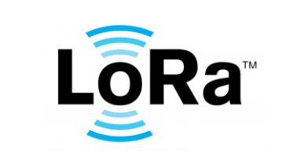



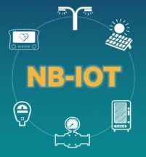
Examples of Narrowband technologies
LoRa stands for Long Range Radio. It is the wireless technology mainly targeted for M2M and IoT networks. This technology will enable public or multi tenant networks to connect multiple applications running in the same network. This LoRa technology will fulfil to develop smart city with the help of LoRa sensors and automated products/applications.
Waspmote is an open source wireless sensor platform specially focused on the implementation of low consumption modes which allows the sensor nodes ("motes") to be completely autonomous, that is battery powered. Lifetime of Waspmote sensor nodes may go from 1 to 5 years depending on the duty cycle and the radio used.
SIGFOX is cellular like system which connects remote devices using Ultra Narrow Band(UNB) technology. It is mainly targeted for low data rate applications. It requires substantially less antennas compare to traditional cellular networks such as GSM/CDMA.
EnOcean is a wireless technology compliant to energy harvesting. It delivers high data rate at low energy consumption. It takes care of multiple simultaneously transmitting devices. More than about 50 manufacturing companies have already created about 200 EnOcean compliant products. It is specified in International Standard ISO/IEC 14543-3-10.
Narrow-Band IoT (NB-IoT) is a technology standardized by the 3GPP standards body.[1] This technology is a narrowband radio technology specially designed for the Internet of Things (IoT), hence its name. Special focus of this standard are on indoor coverage, low cost, long battery life and large number of devices. This technology can be deployed in GSM and LTE spectrum

Slide 5
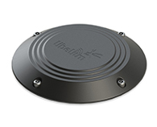
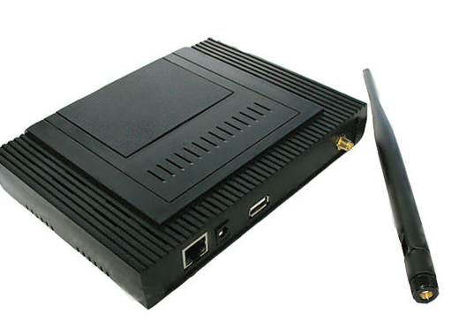
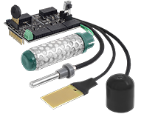
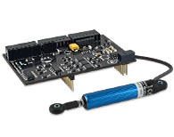
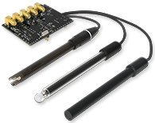
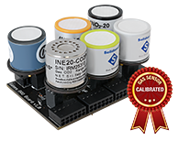
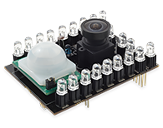
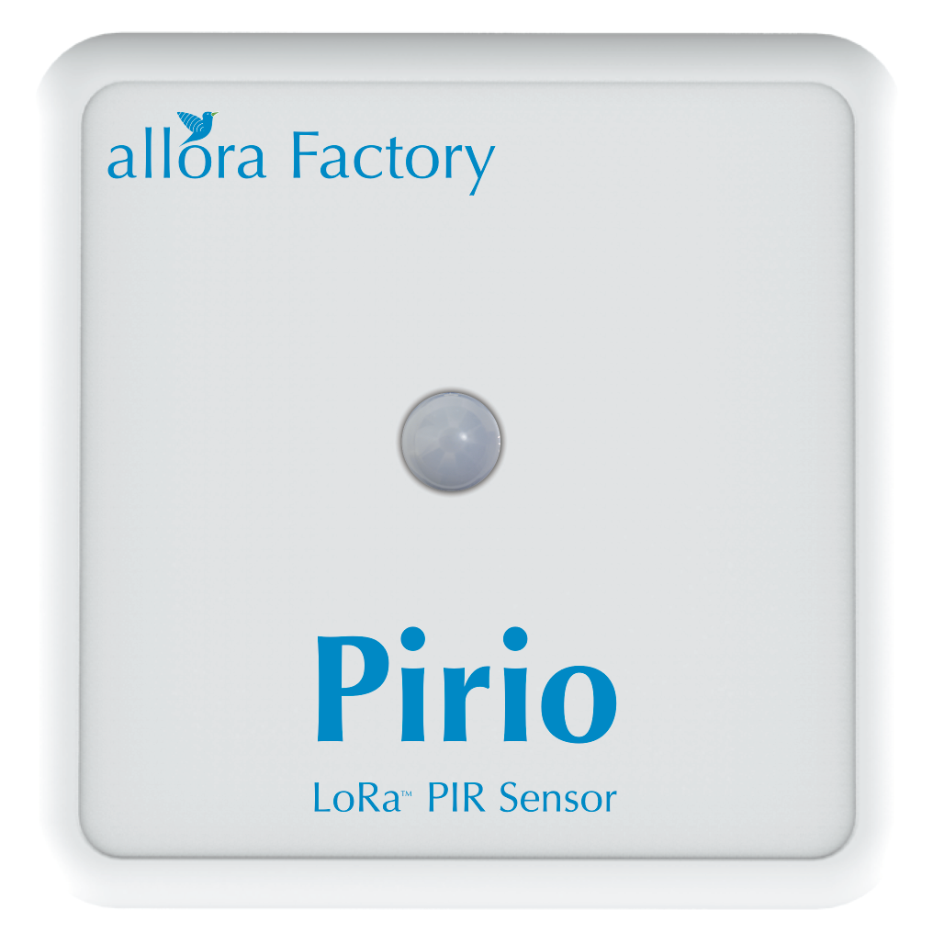
Narrowband IoT Sensors
Moister/Humidity Sensors
Noise/Air Sensors
Parking Sensors
MAC Address Sniffer
Video Sensors
Motion Sensors
Water Quality Sensors
Gas Sensors

Slide 6
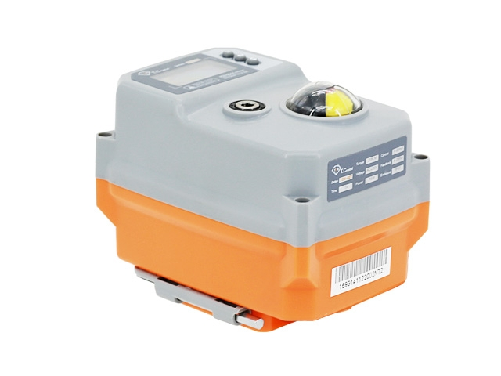
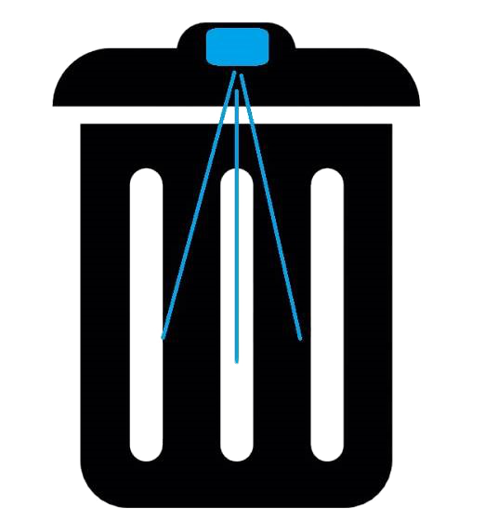
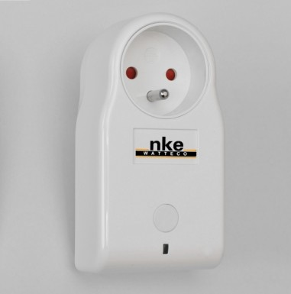
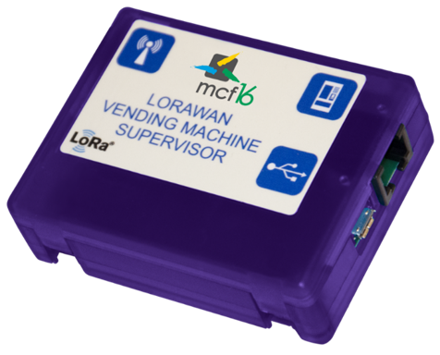
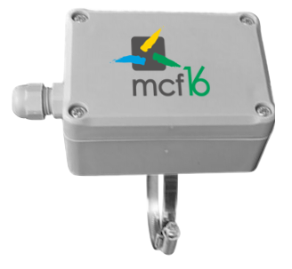
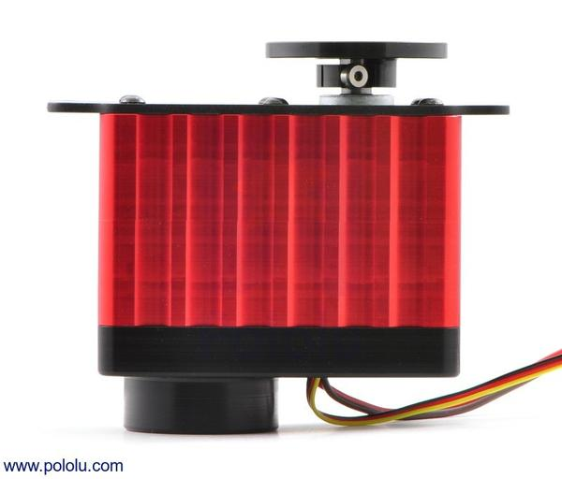
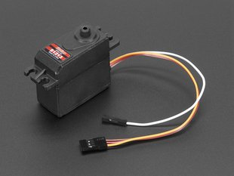
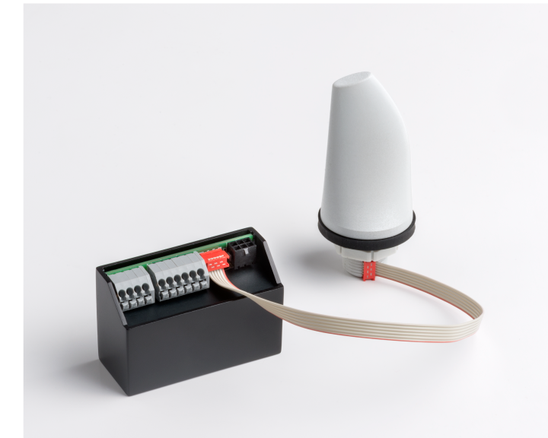
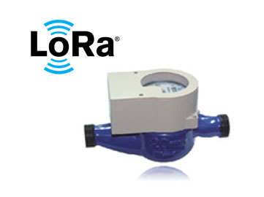
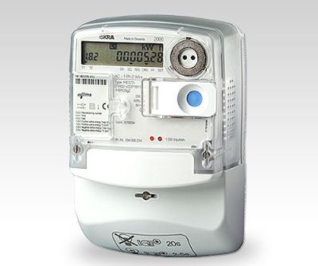
Actuators, Servos & Controls
Smart Plug
Electric Switch
Vending Machine Monitor
Temp Control
Smart Bin
Rotation Servo
Feedback Servo
Street Light Control
Smart water meter
Smart Electricity meter

Slide 7
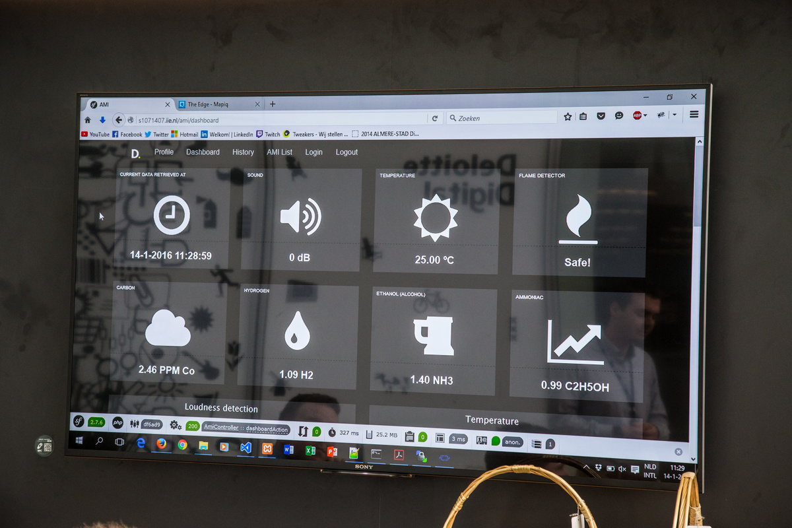
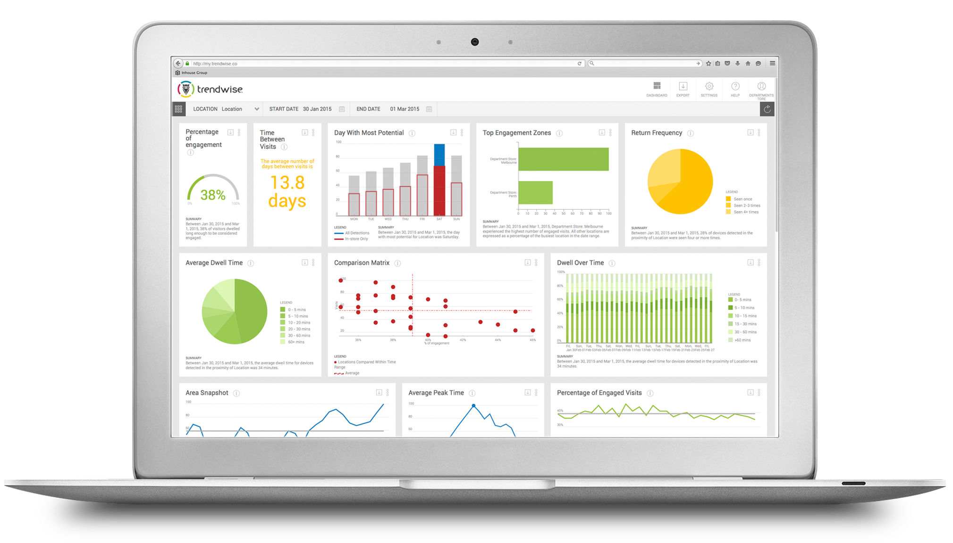
Feeding the Big Data World
Work State Management
Visitor Tracking

Slide 8
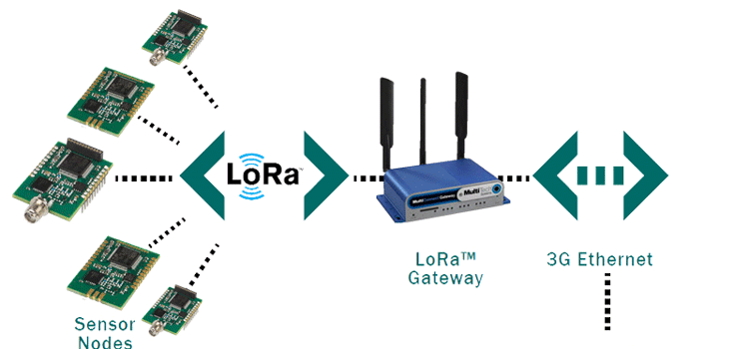

Narrowband option 1: LoRa

Slide 9
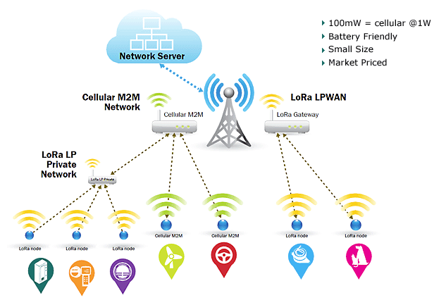
Configurations: LAN & WAN

Slide 10
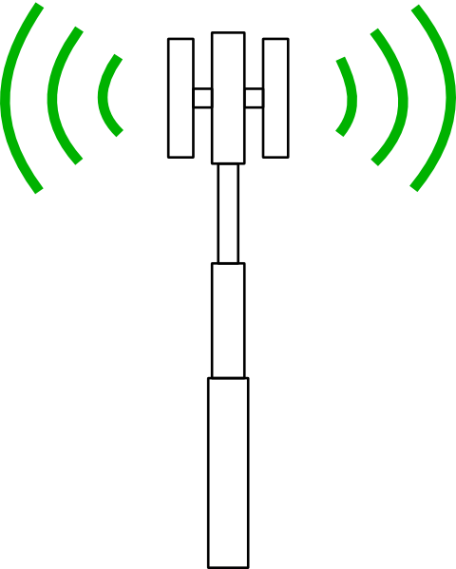
Narrowband option 2: NB-IoT (LTE)
Cat 1
Cat 0/M
NB-IoT
150 – 300 Kbps
10’s Mbps
Up to 1 Mbps
0 to 10 km
0 to 20 km
0 to 35 km

Slide 11
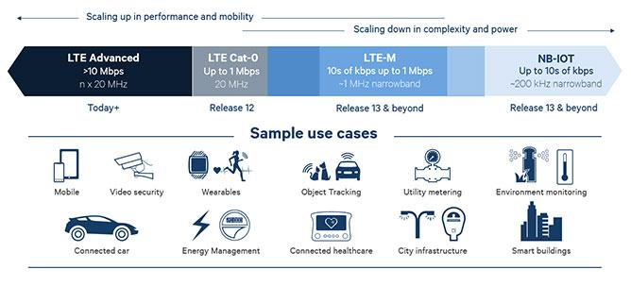
Narrowband option 2: NB-IoT (LTE)

Slide 12
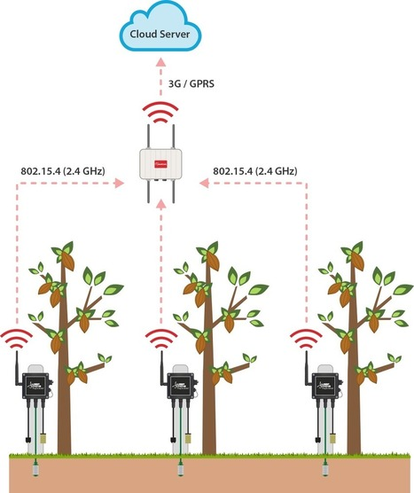
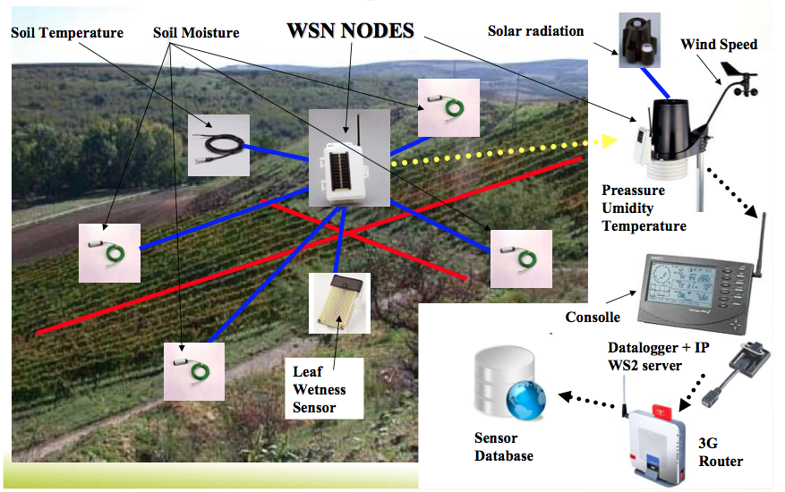
Narrowband & Broadband Integration

Slide 13
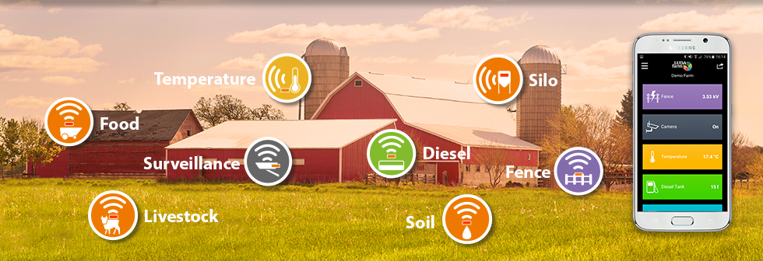
Case Study: Smart Farming

Slide 14
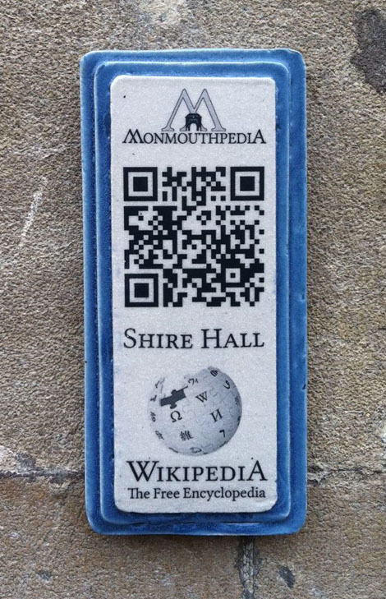
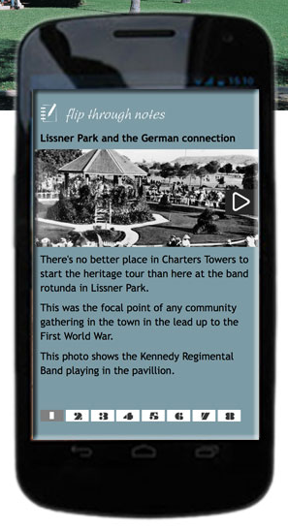
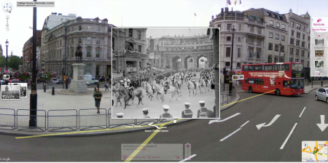
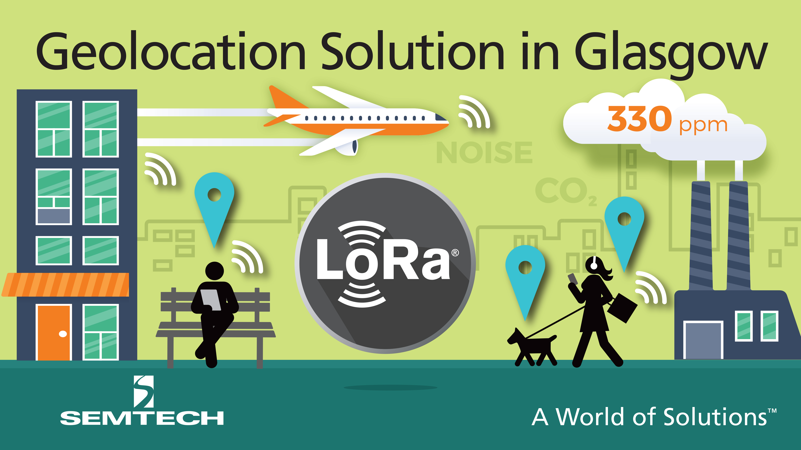
Case Study: Digital Tourism

Slide 15
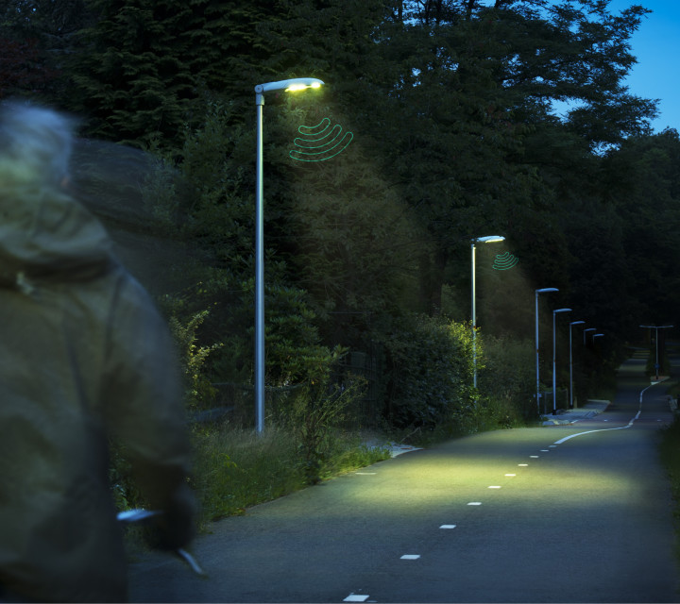
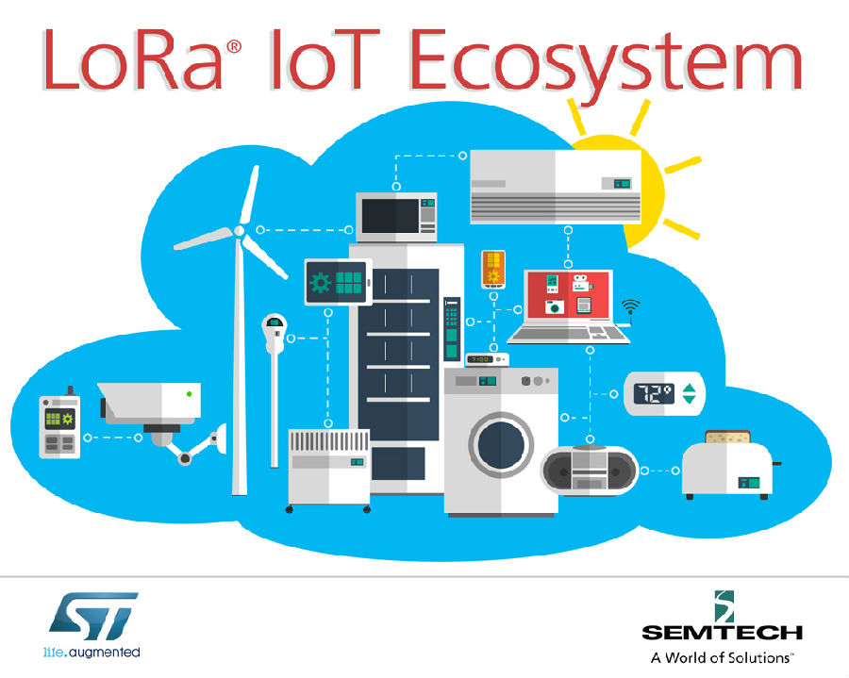
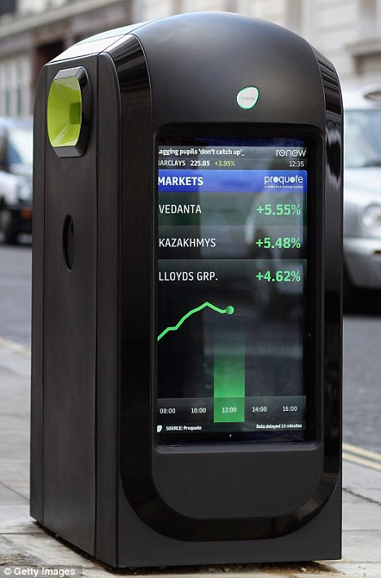
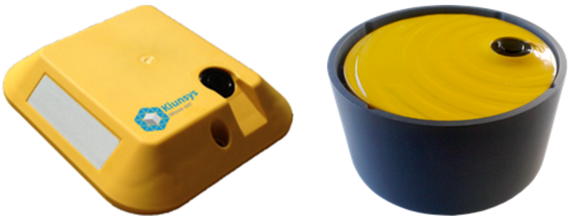
Case Study: Community Management

Slide 16
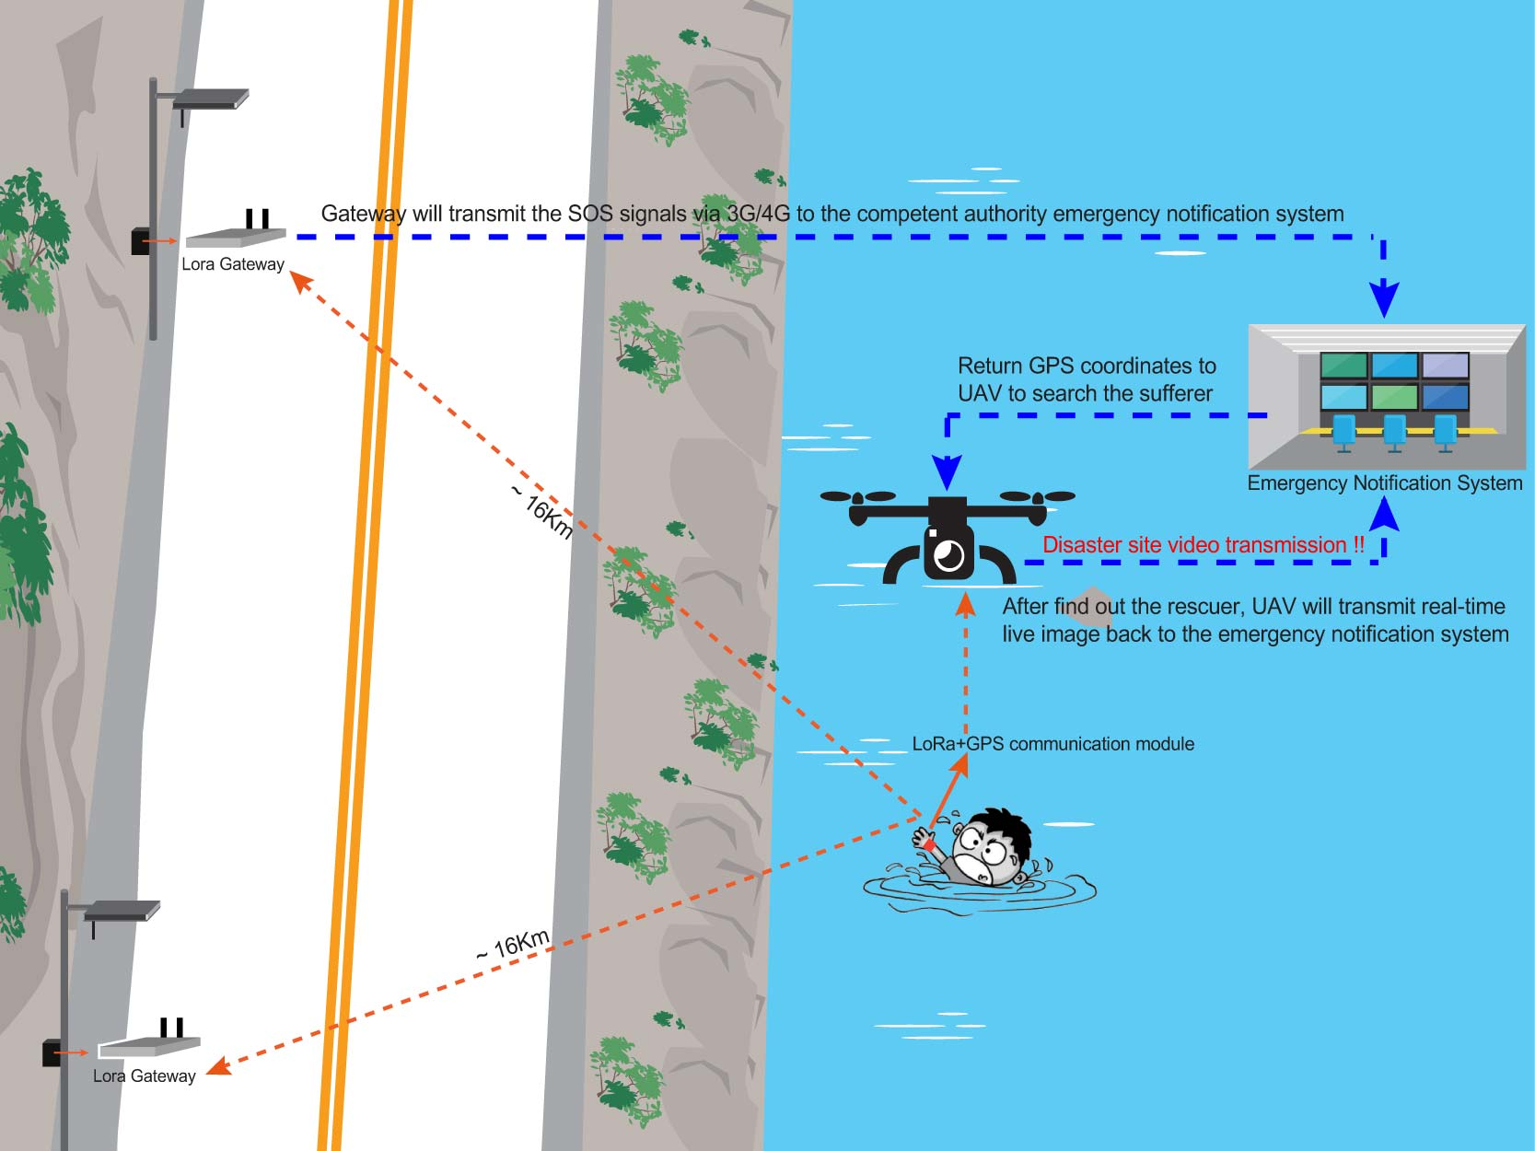
Case Study: Emergency Response

Slide 17
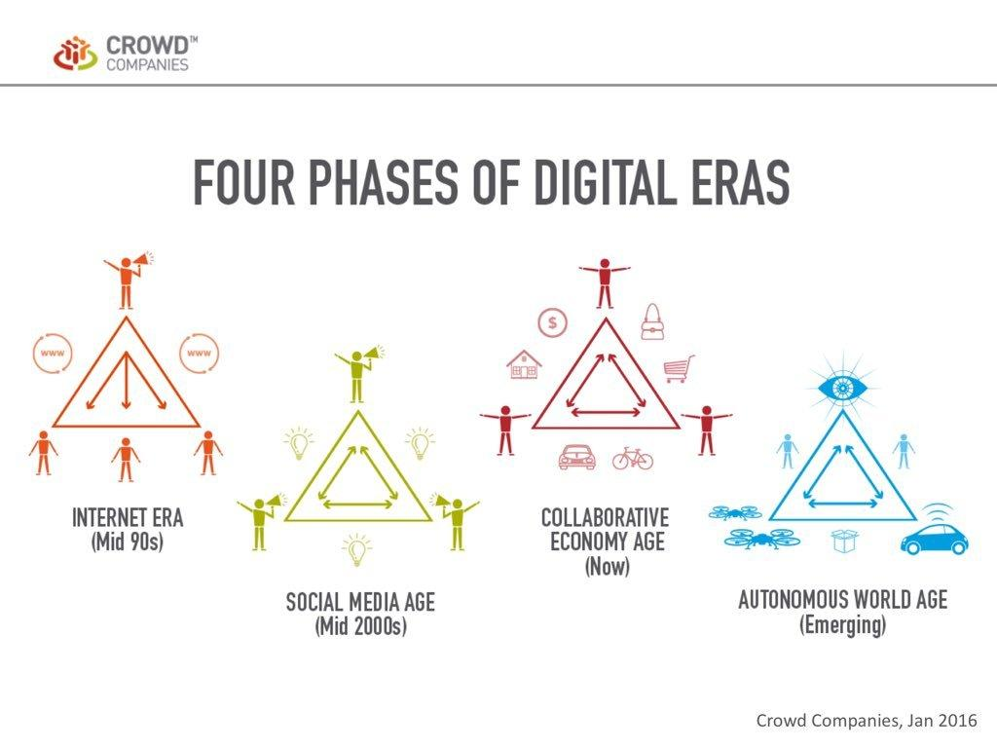
Working towards a Digital Tomorrow

Slide 18
Thankyou
Jim Wyatt
jim@optimidigital.com.au
0408945944

