Slide 1


Digital, Collaboration & Innovation Hubs Summary
Jim Wyatt, September 2015

Slide 2
The concept of Collaboration
At it's core, collaboration is about partnerships. Working in tandem with like-minded people to achieve a common goal and reach a sustainable level of operation. Collaboration can help individuals and SME’s to achieve their shared goals and objectives by:
Reducing costs through pooling resources, sharing common infrastructure and equipment and eliminating potential duplication of services;
Sharing expert knowledge and skills between partners, thereby allowing each individual party to strengthen their own capabilities;
Creating economies of scale for the purpose of procuring goods and services and deploying marketing and promotional activities, to attract new clients and expand into new markets.
The core aims of a collaboration hub or facility are:
1. Providing common user infrastructure, equipment and facilities, to reduce the need for high capital outlay.
2. Bringing people with diverse backgrounds, skills and experience together, to pursue common goals.
3. Supporting new ideas and ventures through mentoring and the sharing of experience and knowledge.

Slide 3
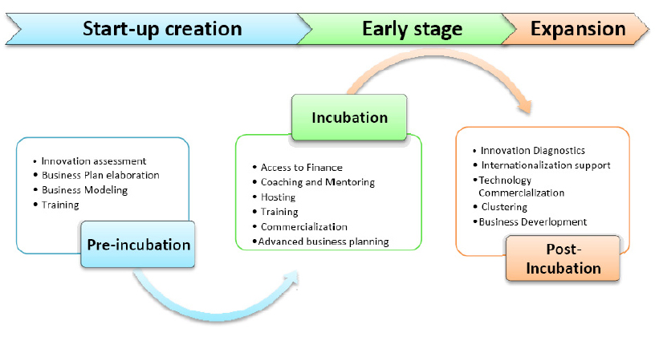
Innovation Incubators
An Innovation Incubator is a business development centre for new entrepreneurs and SMEs that intends to develop innovative ideas and encourage their pursuit. The emphasis is on guiding and assisting new enterprises forming around an innovative idea or concept, to progress to the commercialisation stage. Unlike a collaboration hub which focusses on creating the right environment, the Innovation Incubator also provides access to human capital and expertise, to assist the new enterprise to reach a sustainable footing.

Slide 4
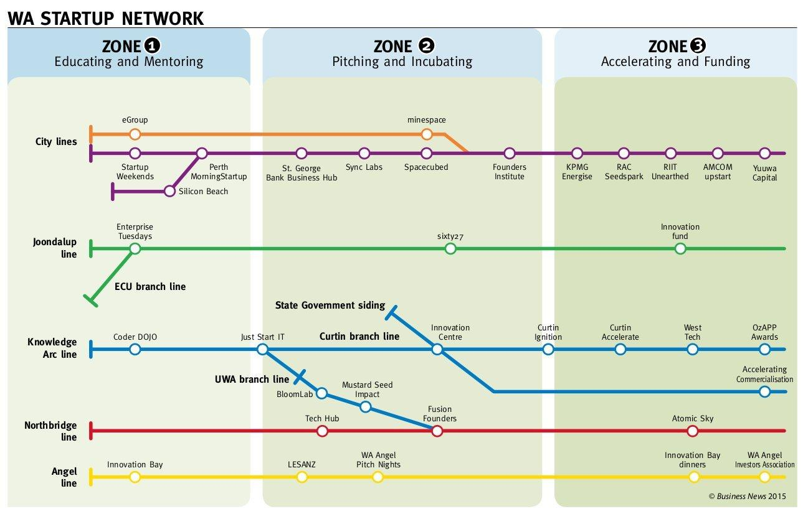
WA Start-up Scene
This infographic shows the diverse ecosystem of start-up, incubator and accelerator programs and organisations that now exist across Perth.
Most of this environment is geared towards technology (ICT/Digital) and the key sectors of the WA economy.
Very CBD and inner city centric with the exception of Joondalup. Shows links to academia and Government.
WA Business News, August 2015

Slide 5

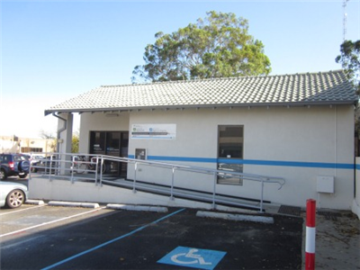
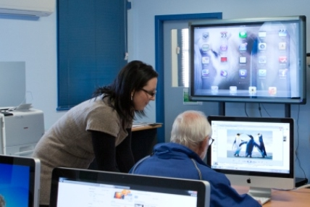
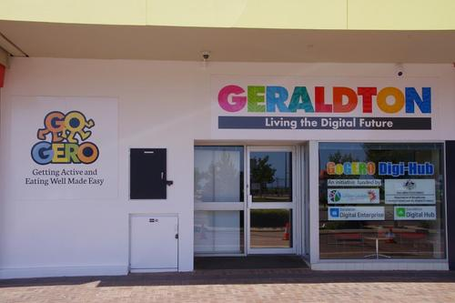
Digital Hubs
The Commonwealth Government funded the establishment of Digital Hubs, to provide training to narrow the gap between those Australians who engage online and those who do not. These Digital Hubs aimed to enable local residents (including SME’s) to increase their online engagement and better understand the opportunities created by the National Broadband Network (NBN) by demonstrating a range of applications enabled by high speed broadband.
Group Sessions
We offer a range of one off topics available in class sizes of 4, including but not limited to:
Computer Basics- Windows and Apple Mac
Internet Basics
Introduction to iPads
Introduction to Android Tablets
Smart Phones
Social Media- including Facebook
Email
Skype
Online TV and Movies
MyGov and eHealth
Exergaming
Digital Photos
eBay
Gumtree
Online Job Seeking
Express Plus Seniors App
Downloading eBooks (eResources)

Slide 6

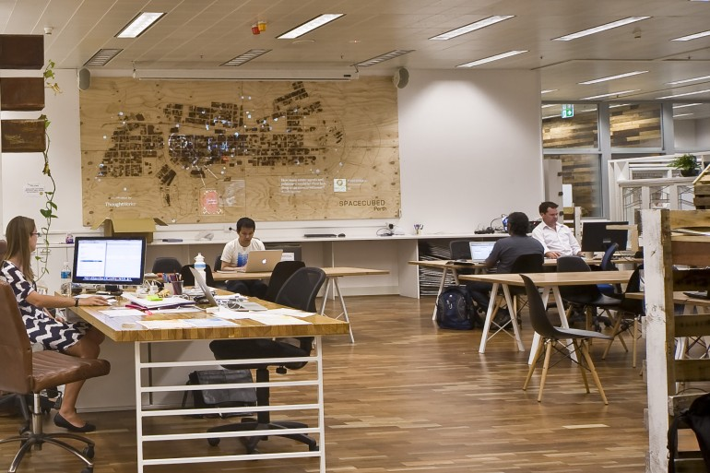
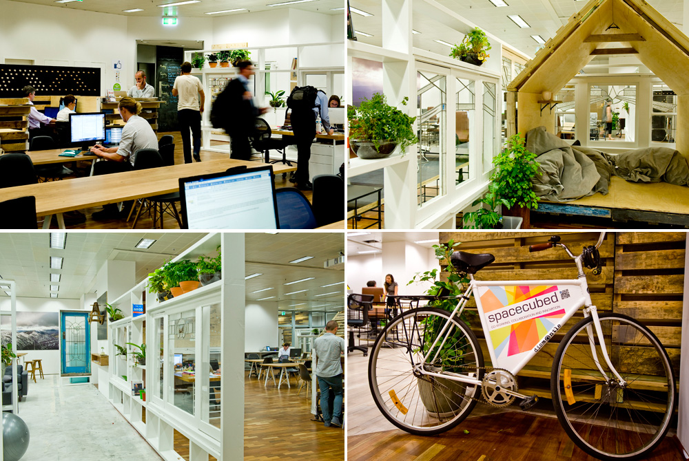
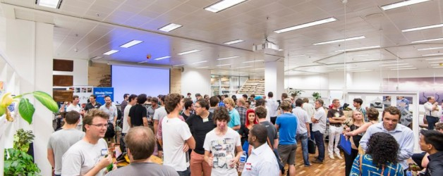
Spacecubed is a 1000 square metre entrepreneurial hub in the heart of the Perth CBD, where teams and individuals can grow their businesses in a supportive, collaborative environment. These spaces have been co-designed with our members – a mix of Entrepreneurs, Innovators and Changemakers who want to get their idea off the ground. To reduce this barrier we offer a range of work spaces, meeting rooms, events and collaboration opportunities.
Spacecubed facilitates a diverse mix of Social, Environmental, Technology and Creative entrepreneurs. There is also a range of Small Businesses, Consultants, Corporates, Government and Not for Profit Members. At it\’s core, Spacecubed is about increasing opportunities for Collaboration and Innovation across different industries. http://spacecubed.com/

Slide 7

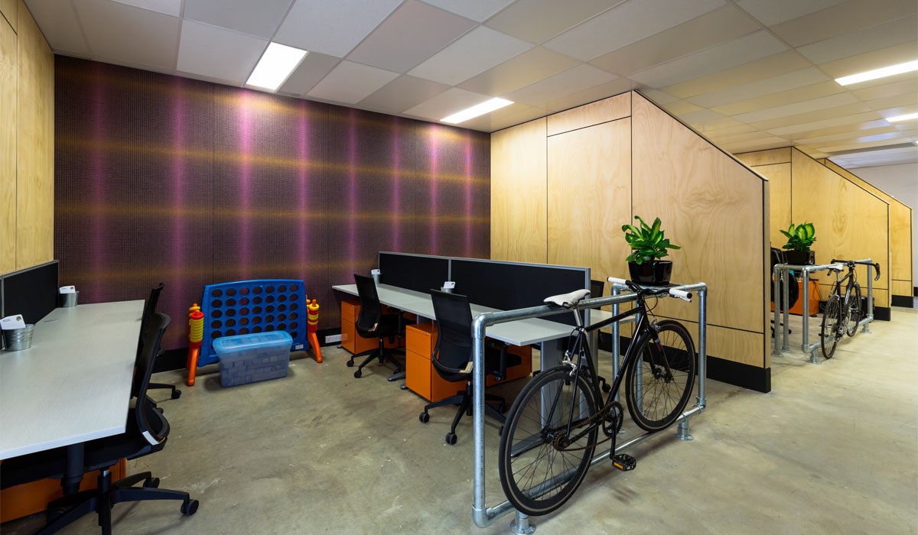
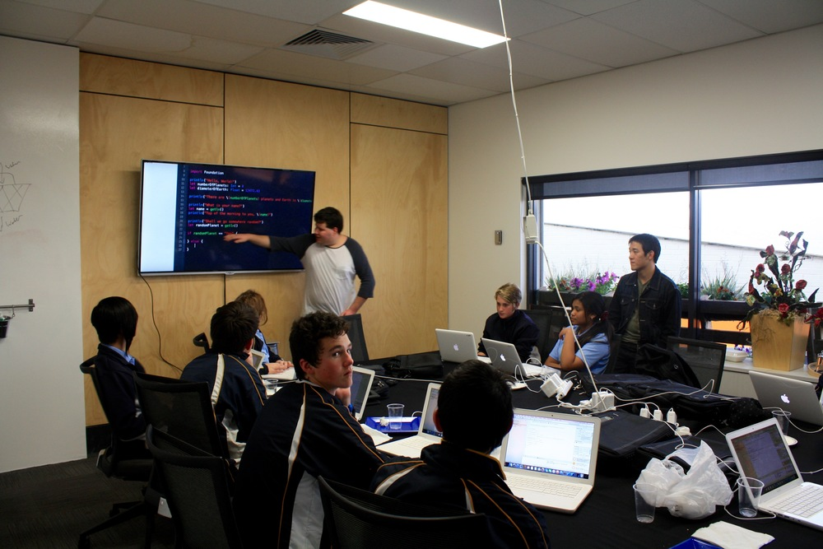
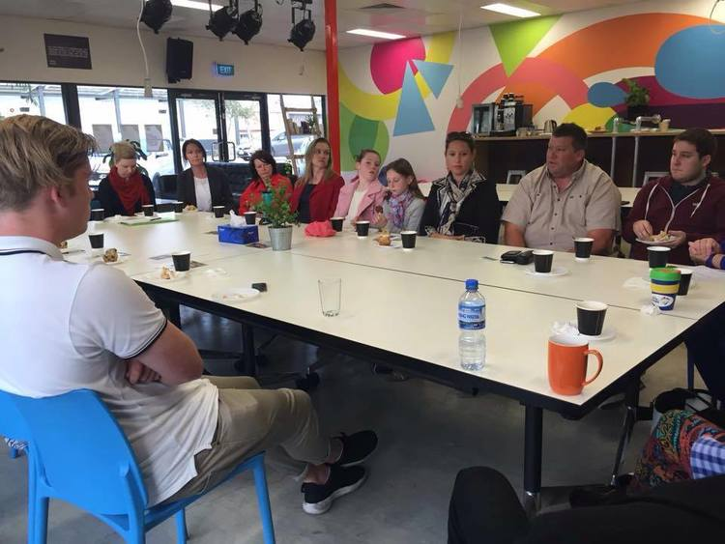
Make Place is described as the “ maker factory”, where game changing innovation happens. The Makers have created a co-working and innovation space in the heart of Mandurah, bringing like-minded people together to be inspired, solve problems and make change. The centre aims to provide a bit of inspiration in the form of a new type of workplace filled with different people. If you have a big new idea, run a business, study, freelance or commute, or you just need a motivating place to work, Make place is the location for you!
Make Place is also staffed with a team of Makers who’s aim is to assist you achieve change. http://www.themakers.org.au/the-makers/

Slide 8

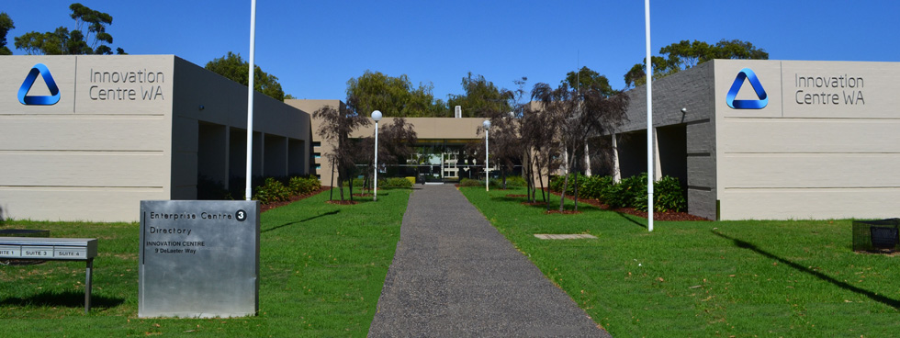
Located in the Technology Park Bentley, the Innovation Centre currently works with 12 private companies in the Business Incubator ranging from clean tech and ICT to mining solutions and offers world-class support for innovators and growing local ventures. The Innovation Centre of WA offers HotDesks and very affordable meeting rooms in a friendly flexible working environment that is ideal for motivated innovators, entrepreneurs and start-ups.
The Innovation Centre facility includes a Business Incubator which provides serviced offices, free wi-fi, meeting rooms and consulting support, and education and networking for both start-ups in the early idea stage as well as growth businesses. The centre also provides seminar and conference facilities, to support training and information events aimed ant assisting businesses engage in innovative practices.

Slide 9

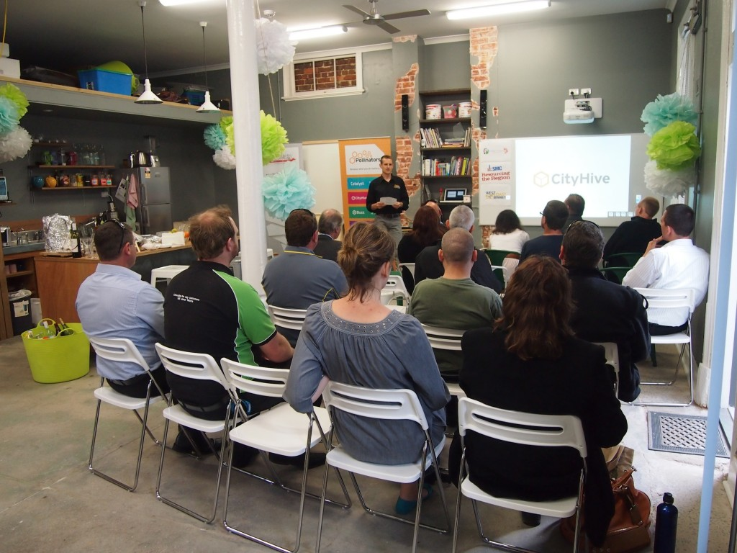
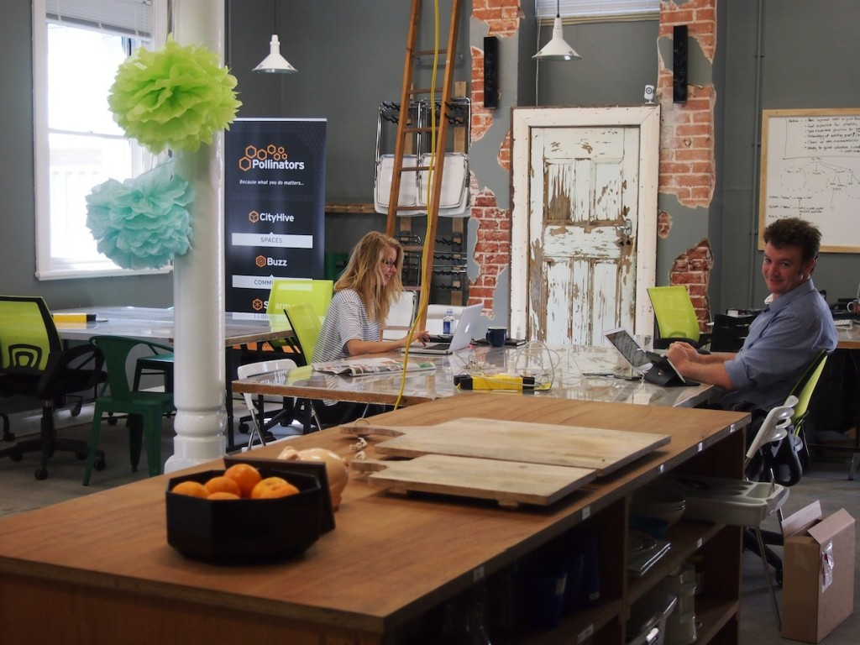
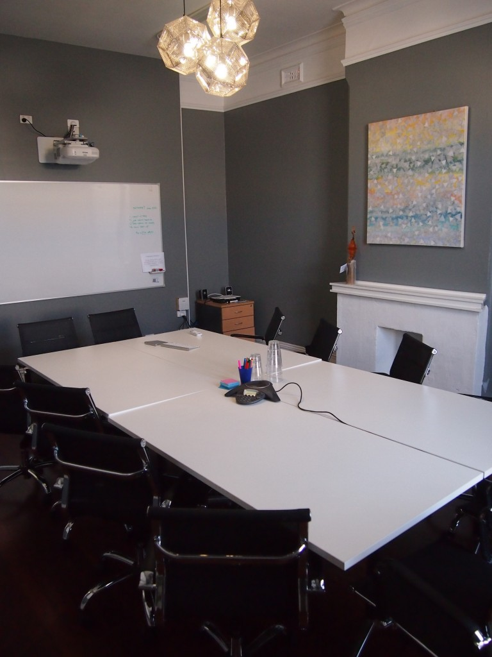
CityHive is run by Pollinators to provide coworking, meeting, event and office space on Marine Tce in the Geraldton CBD. Whether your version of ‘getting things done’ requires coffee, a team of twenty, or a quiet space for creating on your own, you can find it at CityHive. Pollinators Inc also provides a range of training, networking and collaboration events at CityHive. CityHive’s professional and inspiring co-working and private offices, casual and corporate meeting spaces are all offered at varying rates depending on the duration and frequency of use.

Slide 10

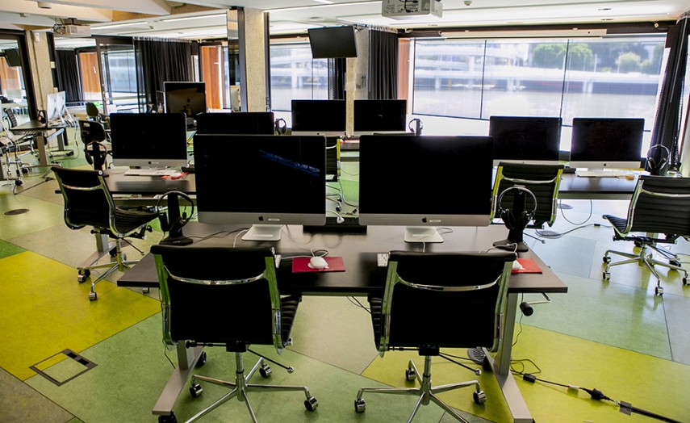
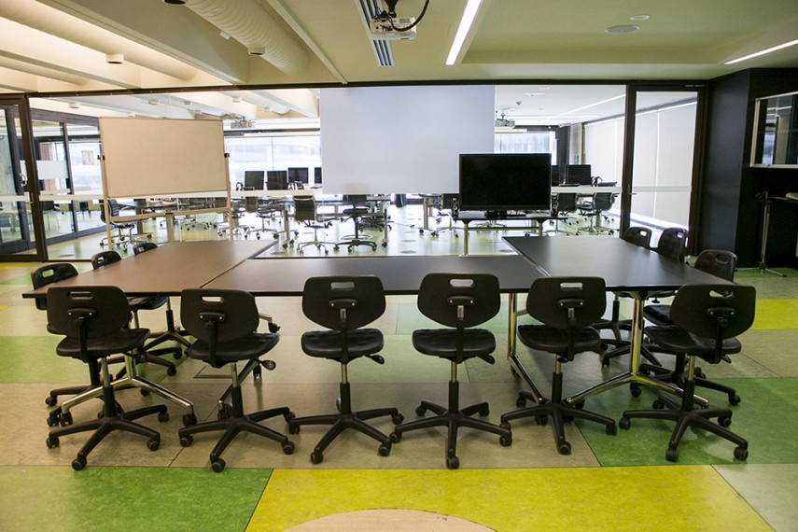
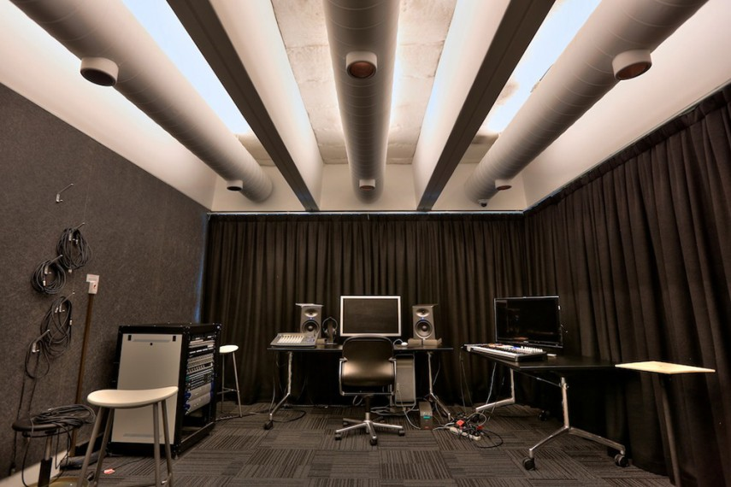
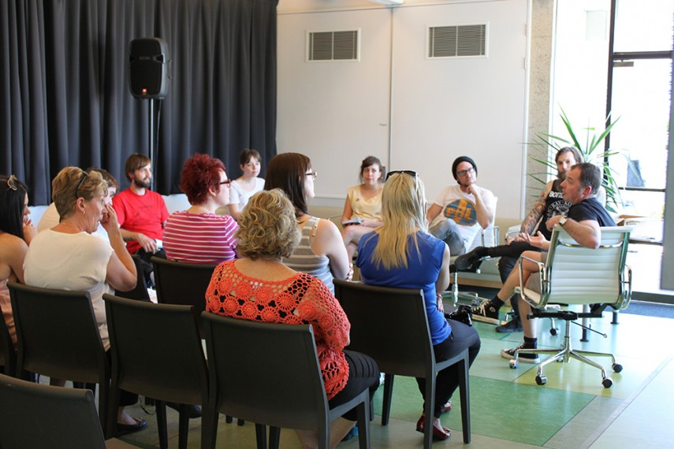
Conceived as a model for the library of the future, The Edge, launched by State Library of Queensland (SLQ) in 2010, is at the forefront of re-imagining libraries for the 21st century. With a mandate to empower Queenslanders to explore creativity across art, science, technology, and enterprise, The Edge is a visionary space for ‘creating creatives’; a melting pot of ideas and innovation, capacity-building, experimentation and innovation.
Media Lab
Innovation Lab
Studio
Collaboration

Slide 11

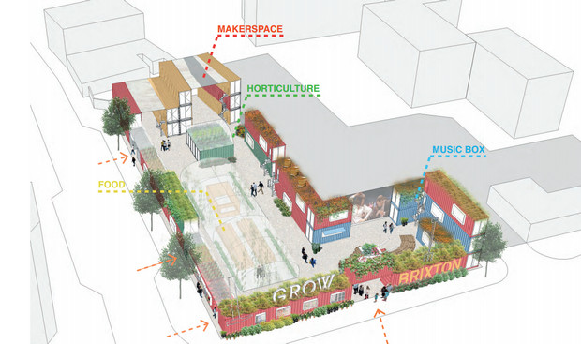
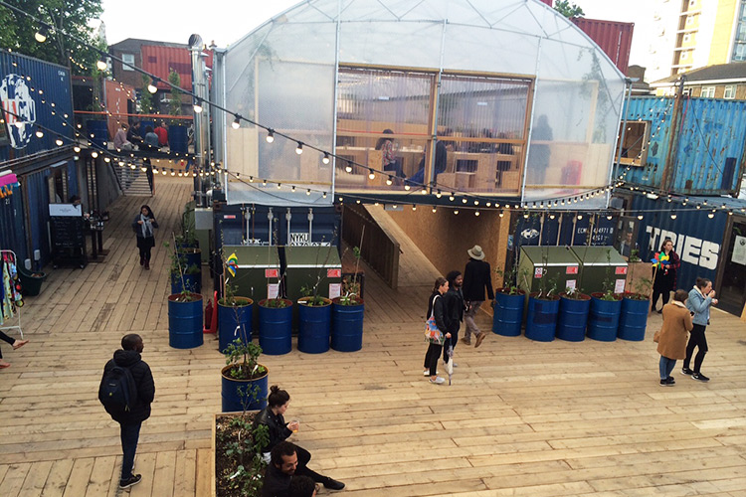
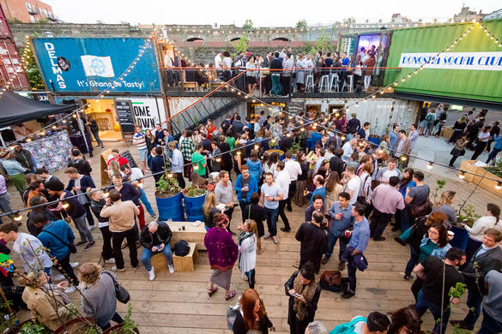
Pop Brixton is a pioneering new space created with the local community in mind to showcase the best and most exciting independent start-ups and businesses from Brixton and Lambeth (London UK), where they can share space, skills and ideas. Pop Brixton will house the next generation of local food and drinks entrepreneurs, retail outlets, workspaces for local business and artists, tech enterprises and a community event space, to be enjoyed by all. Affordable space for start-ups and small businesses is provided with 10 units available at 20-50% of market rate.

Slide 12

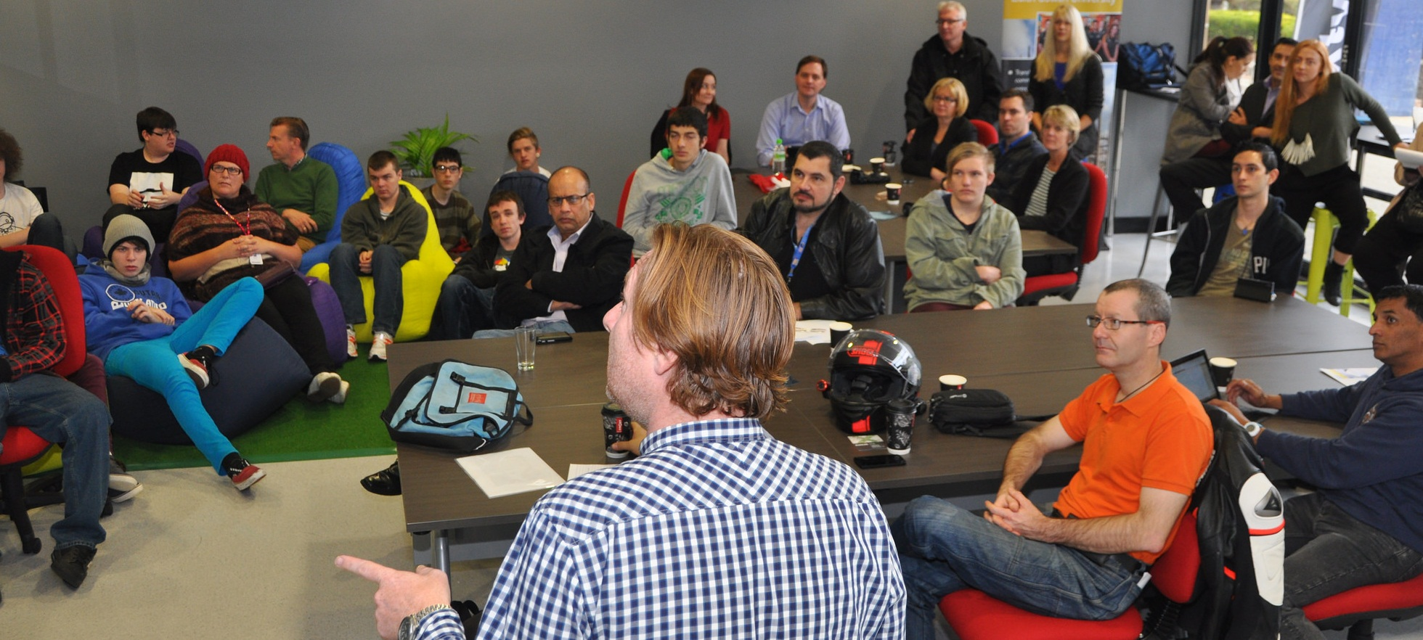
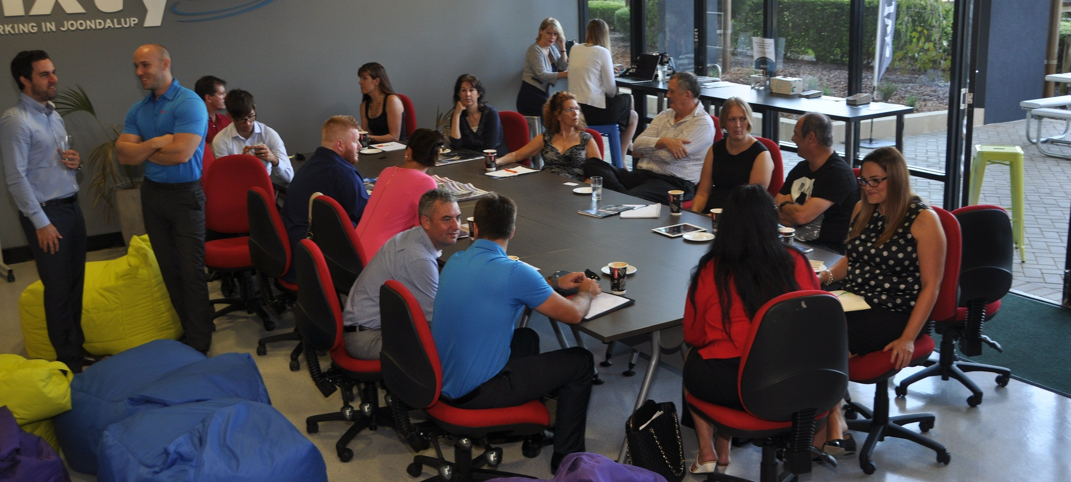
Sixty27 aims to encourage local talent and entrepreneurship, providing small businesses in the northern corridor with a place to grow, develop and thrive. West Coast Institute and the City of Joondalup began working on the Sixty27 concept in August 2013. The City had just committed to its Digital City Strategy and what started as a joking comment about the beautiful, wasted, lakeside vista on the West Coast Institute Campus soon became the basis for the creation of a coworking space that would become Sixty27. The aim is to establish a willing community of creators, innovators and collaborators who see potential in their own backyard and are willing to invest in making Joondalup, Wanneroo and all it’s surrounds into the best it can be.

Slide 13
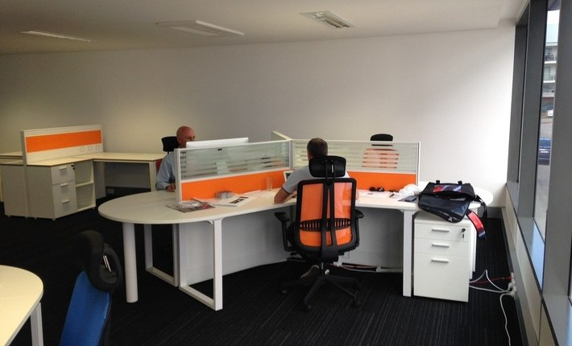
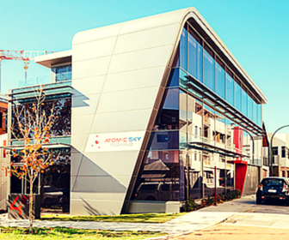
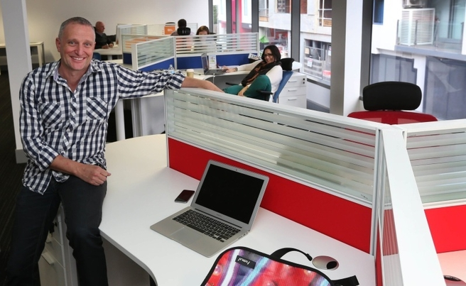
Atomix Sky’s Tech Hub is described as Perth’s most experienced coworking space and most driven tech community. Rebranded at the beginning of 2015, the Tech Hub is now standing on its own two feet as a coworking space in Perth. Unlike other coworking spaces in Perth, the Tech Hub is the first of its kind that gives entrepreneurs the opportunity to learn from Perth’s best commercialisation specialists. Atomic Sky provides Tech Hub community members the opportunity to work alongside those who have already built, grown and sold successful businesses in a multitude of industries. For more information on the Tech Hub coworking space and to become a member, head over to www.techhub.io

Slide 14

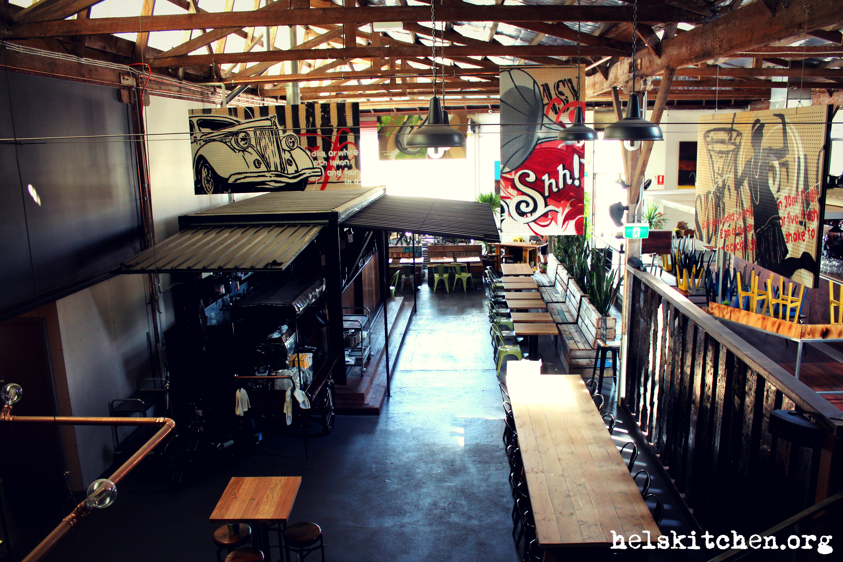
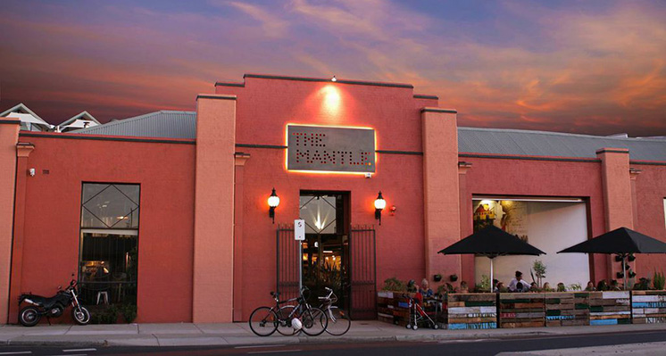
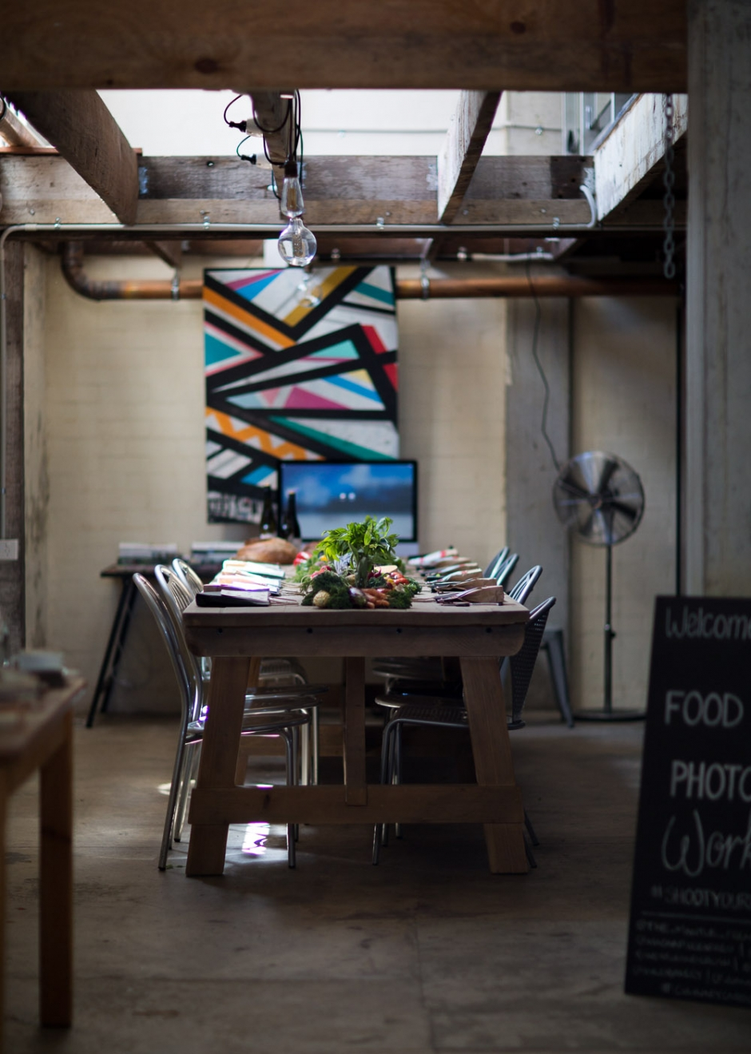
The Mantle is an activity hub in the new East End of Fremantle; a place where people come together to eat, drink, work and play. Set inside a beautiful historic warehouse; transformed with the use of innovative structures, materials and art. The Mantle houses several restaurants, a cocktail bar, an incubation kitchen, collaborative working space and arts. The Kitchen @ The Mantle is an incubation kitchen for talented chefs and entrepreneurs in the food game; home to pop up restaurants and production of many tasty goods. Collabor8 @ The Mantle is a collaborative space consisting of hot desks and artist spaces.

Slide 15

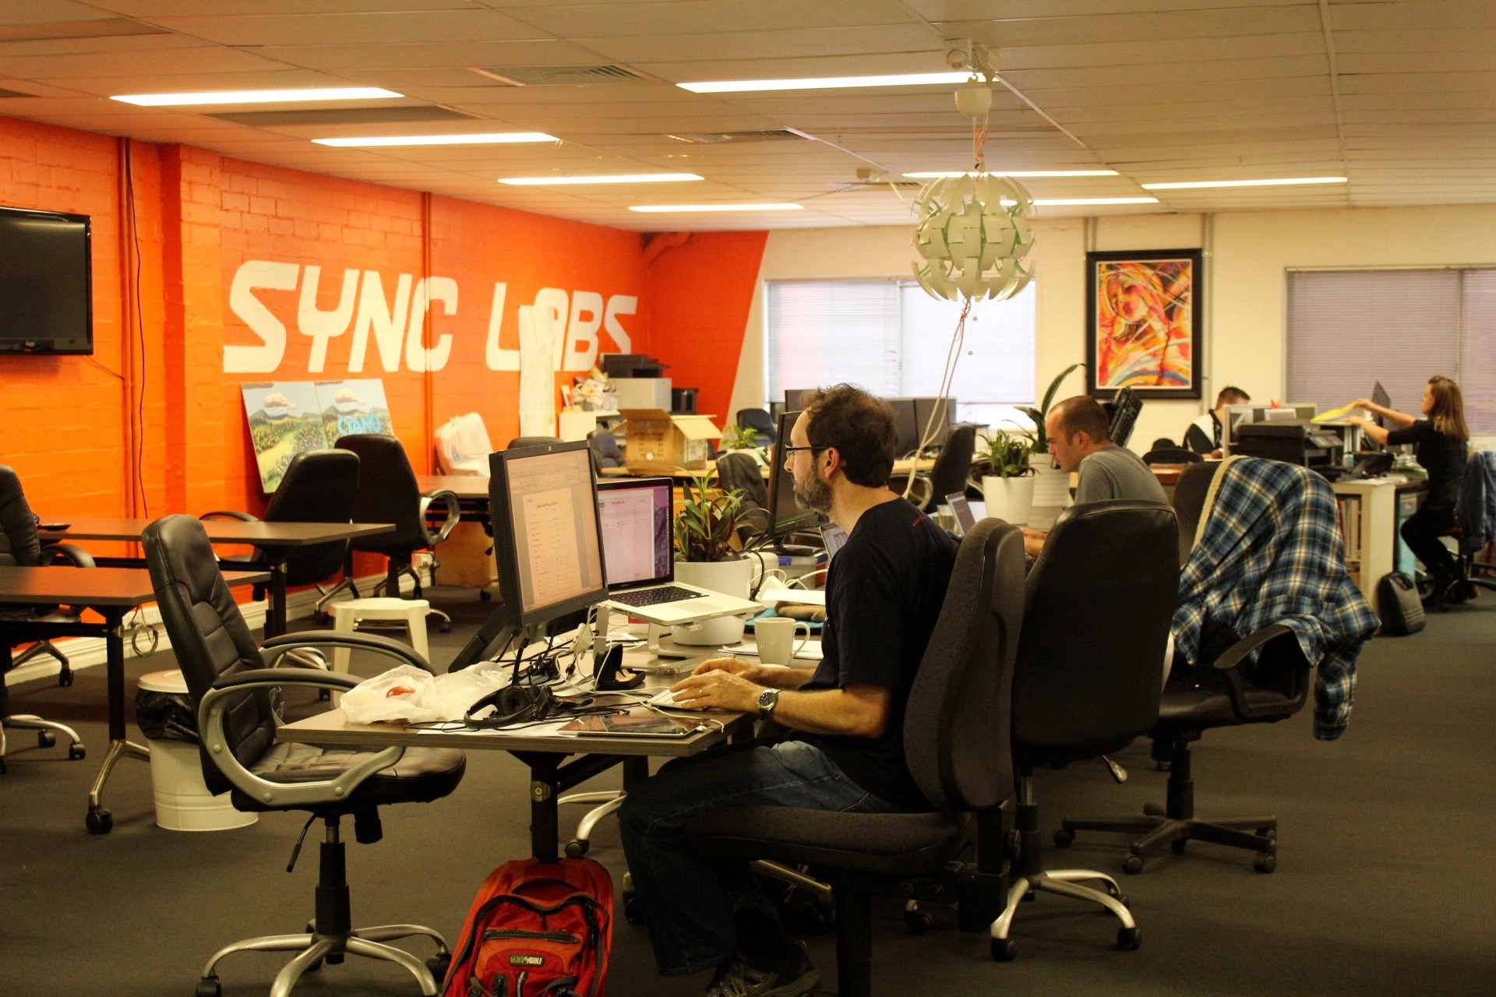
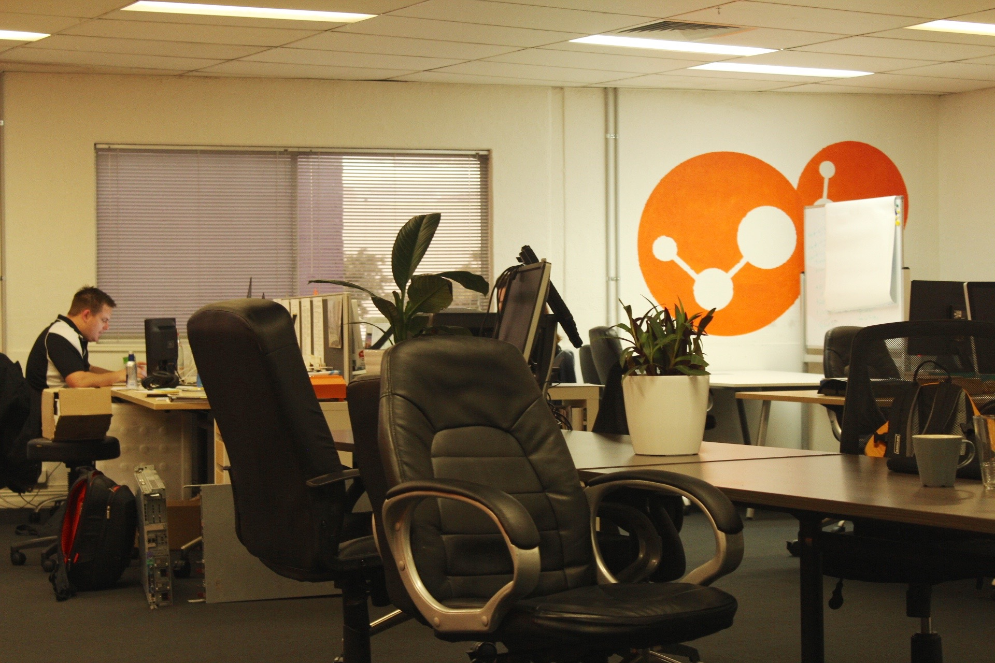
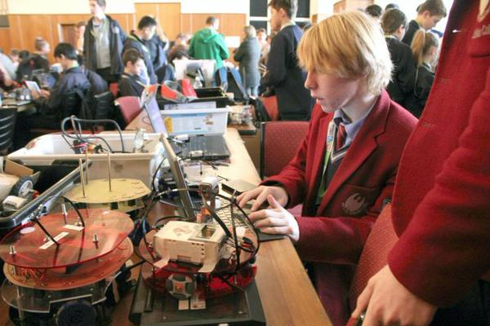
Sync Labs is Leederville’s premiere coworking space designed for Perth’s tech start-up community, but open to all industries. Its goal is to bring together investors, developers, designers, entrepreneurs and ideas people from across different industries into one space. The Lab also provides access to some great deals for its resident community through supporting service providers such as R&D tax advice, cloud infrastructure services and IP protection. Sync Labs recently joined forces with the Spacecubed team, which means members get access to more resources and an even bigger community of likeminded folk doing incredible things. Between Sync Labs and Spacecubed the community now extends to over 650 Entrepreneurs, Innovators.

Slide 16



Virtual Models & Hacks
Unearthed is a unique 54-hour long event focused on the resources sector. Software developers, designers, and industry insiders will come together to develop prototype solutions to resources sector problems. Unearthed participants will have a chance to work on proprietary industry data as well as data from our government partners.
GovHack brings together programmers, designers, entrepreneurs, archivists and librarians, and enthusiasts with all kinds of backgrounds in a room together to work with government data, to innovate and create. It’s about growing Australia’s technical and creative capacity, connecting citizens with government and the public sector, and about building on the social and economic value of open data published by government.
Startup Weekend events follow the same basic model: anyone is welcome to pitch their startup idea and receive feedback from their peers. Teams organically form around the top ideas (as determined by popular vote) and then it’s a 54 hour frenzy of business model creation, coding, designing, and market validation. The weekends culminate with presentations in front of local entrepreneurial leaders with another opportunity for critical feedback.

Slide 17
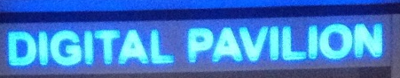
Digital Pavilion Model
An engaging digital technology, applications and content experiential space for local business and community groups to engage with cutting edge innovation and thought leadership focused on the digital economy and participation within it.
Operations Model
Involves demonstration, collaboration, interactive and experiential spaces;
Deliver targeted onsite programs supporting digital engagement for community & business;
Encourages local innovators to interact with national & multinational digital enterprises;
Operates under a “Switzerland” culture that encourages collaboration and open-mindedness;
Undertakes themed periodic demonstrations and promotional events focusing on specific sectors or technology trends;
Provides a collaboration “sandpit” for local innovators to engage with local academia, established sector providers and thought leaders, to develop new business models and start-up ventures; and
Supports local innovators and start-up ventures through facilitation and access to common use resources and equipment and commercialization pathways and contacts.
The Digital Pavilion will aim to leverage and exploit State and national infrastructure investment projects, funding programs and network engagement events to benefit local innovators and start-up players.

Slide 18
The Swan Digital Pavilion
Innovation & Collaboration
Experience & Education
Demonstration
Digital literacy
Promotion events
Digital engagement
“Digital Hub”
Coworking
Hacks
School & TAFE links
Start-up Programs
Common User facilities
Incubation & Commercialisation
Computer – media lab
Meeting – collaboration lab
Developer “sandpit”
Creative studio
Business planning
Mentors
Investment & funding
Facilities hire
Promotion & networking

Slide 19
Thankyou
Jim Wyatt, August 2015

