Slide 1





Regional Telecommunications
Jim Wyatt, Albany, August 2017

Slide 2
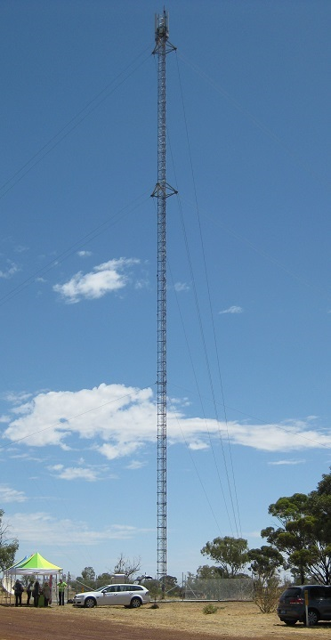
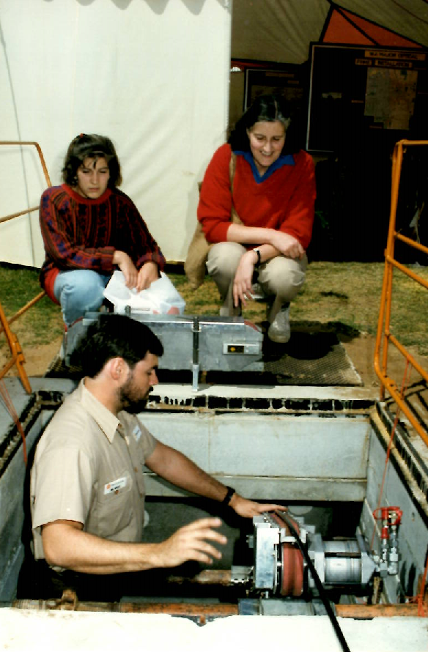

30 plus years around Telecommunications
Qld poaches Tassie broadband chief
By Renai LeMay - 07/04/2010
Queensland Government has poached one of the lead architects of Tasmania’s early stage participation in the National Broadband Network rollout to help lead its own broadband strategy.
Jim Wyatt, the assistant general manager at Tasmania’s Department of Economic Development, is understood to be taking up a role as Queensland’s director of Telecommunications and Broadband Strategy, based in Brisbane and starting next Monday. He did not immediately return calls on the matter today.
Brisbane 2010
Telecom 1986
Kukerin 2017
RMCP, Kondinin 2014

Slide 3
Regional Telecommunication, WA’s Focus: A Story in Parts
2010 to 2014
Emergency Services & major road coverage – mobile
Community Emergency Mobile Communications Project – Balingup, Kukerin and Quongup - $1.2 million
Regional Mobile Communications Project – 113 sites across the State in partnership with Telstra - $40 million
Community Safety Network - replace the Police Regional Radio Network with a “fit-for-purpose”
digital regional radio communications network – $94.5 million
2013 to 2016
Mobile Black Spots, NBN & services equality
RMCP Phase 2 – 22 new mobile sites in towns across the State, in partnership with Telstra - $10 million
RTP stage 1 – 130 mobile sites across the State in partnership with Commonwealth MBSP, Telstra and Vodafone - $32 million
9 Regional Blueprints include a focus on Digital & Communications
2015 to 2018
Digital Disruption & regional services delivery
RTP stage 2 – 78 mobile sites across the State in partnership with Commonwealth MBSP, Telstra and Optus - $21.8 million
WA State Agricultural Telecommunications Infrastructure Improvement Fund - $22 million – Yet to commence
WA Regional Telecommunications Plan 2018 to 2020???
Premier's Fellow in Agriculture and Food – Simon Cook
2017 to 2020
State-wide Improvement Plan and Roadmap
Deliver on Regional Blueprints
Address NBN deficiencies
Fit for Purpose technology to support Smart Industry
Public Services Innovation and Regional Delivery
Leverage investment to date
Better access & affordability
Competition & Coverage

Slide 4
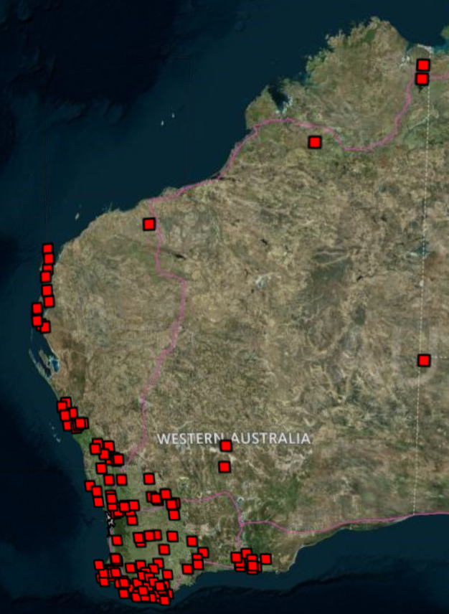
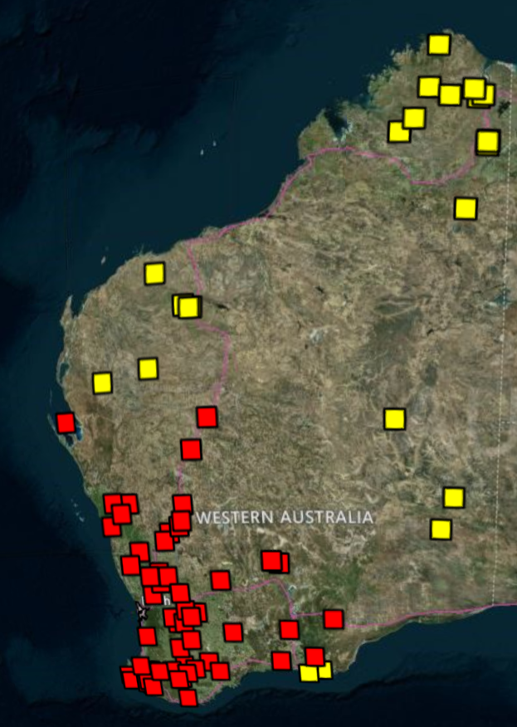
Success so far

Slide 5
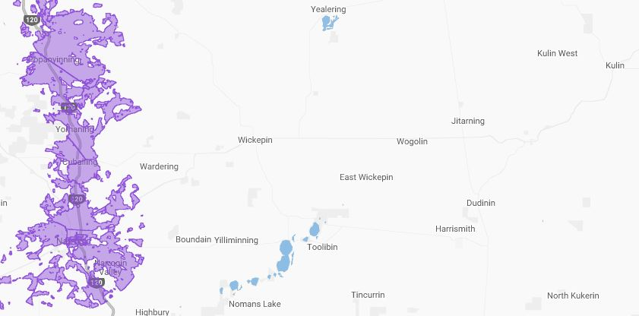
The NBN & Mobile Blackspots conundrum
WA RMCP Sites
Wickepin - 2014
East Wickepin - 2016
MBSP Sites
Yealering: MBSP-WA-130
Tincurrin: MBSP-WA-066
Kulin West: MBSP-030

Slide 6
NBN Satellite vs Mobile Broadband: WA Baselines
Residential
Business
Cranbrook West
Cranbrook West
Broadband | ADSL | Satellite | Wireless/Mobile | NBN/Other
2015 | DNM | DNM | DNM | DNM
2016 | 0% | 10% | 50% | 40%
Broadband | ADSL | Satellite | Wireless/Mobile | NBN/Other
2015 | 18% | 44% | 38% | 0%
2016 | 0% | 14% | 14% | 62%
Nyabing
Nyabing
Broadband | ADSL | Satellite | Wireless/Mobile | NBN/Other
2015 | DNM | DNM | DNM | DNM
2016 | 18% | 36% | 37% | 9%
Broadband | ADSL | Satellite | Wireless/Mobile | NBN/Other
2015 | 0% | 14% | 86% | 0%
2016 | 16% | 39% | 86% | 39%
Wickepin
Wickepin
Broadband | ADSL | Satellite | Wireless/Mobile | NBN/Other
2015 | DNM | DNM | DNM | DNM
2016 | 27% | 20% | 27% | 26%
Broadband | ADSL | Satellite | Wireless/Mobile | NBN/Other
2015 | 0% | 33% | 67% | 0%
2016 | 21% | 10% | 90% | 28%
Yerecoin
Yerecoin
Broadband | ADSL | Satellite | Wireless/Mobile | NBN/Other
2015 | DNM | DNM | DNM | DNM
2016 | 8% | 42% | 33% | 16%
Broadband | ADSL | Satellite | Wireless/Mobile | NBN/Other
2015 | 0% | 63% | 25% | 13%
2016 | 0% | 13% | 54% | 33%
Source: Optimi Digital – WA RMCP Baseline Study, 2015 to 2016

Slide 7
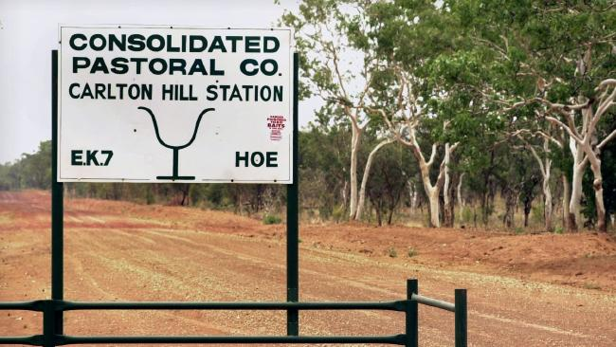
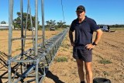
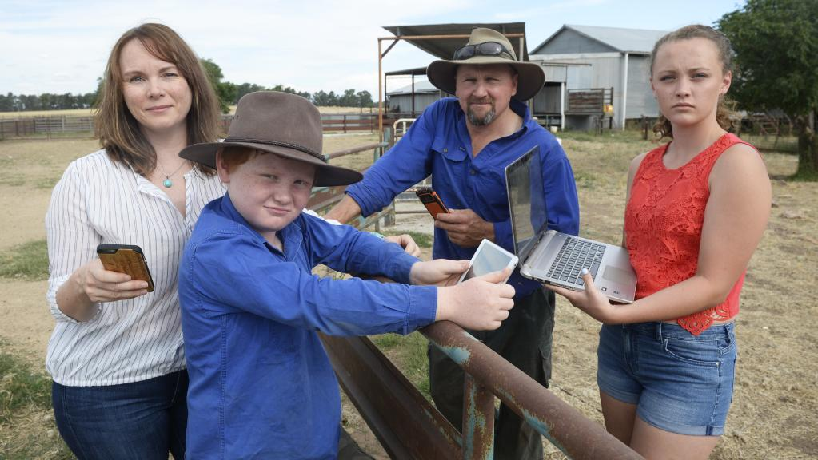
The Bush is full of Businesses – Is NBN up to the task?
Consolidated Pastoral Company rolls out $750,000 internet service
Farmers forced to go to extreme lengths to access reliable internet
Data Drought: Satellite NBN service failing to pass muster
A south-west Queensland cotton grower has spent the recent school holidays building a 53-metre tower that will allow him to access high speed internet from a nearby town.
It is an innovative solution to the data drought plaguing so many in rural Australia, and Andrew Sevil hopes it will future-proof his property.
"I'm not comfortable with Sky Muster due to latency using the satellite technology, so we made a decision a couple of years ago and it's just been a project we've been working on for a little while.“ Mr Sevil said he was motivated by the need for a good, reliable internet connection.
FARMER Lee Longmire is astounded the NBN Sky Muster satellite is being touted “as the be all and end all for rural and regional residents”.
“The reality is it’s a third-rate service that goes nowhere near giving satellite users equity or parity with fixed wireless or cable NBN customers,” Ms Longmire, of Sandigo NSW, said.
Ms Longmire and her husband, Geoff, have tried and failed to use cloud-based accounting software, reverting instead to a $600-$700 a month mobile plan to gain 142 gigabytes of data.
Skymuster NBN not an option for CPC. Mr Setter said no minimum service guarantees from the Skymuster NBN made it too unreliable for them to use.
"It's just not simply going to be good enough for us to run basic internet connectivity," he said.
"We wouldn't be able to use VOIP [Voice over Internet Protocol] or any [enterprise resource planning] applications to without predictable internet speeds and the NBN doesn't do that for us."
Notes:
Cybersecurity is essential to ALL 400+ Digital Value at Stake use cases — speed of adoption depends on it
Cybersecurity has the potential to drive $7.6 trillion in Digital Value at Stake across private and public sectors over the next decade
22% of this estimate ($1.7 trillion) applies to protection of intellectual property and avoidance of data breach costs
78%, or $5.9 trillion, is dependent upon organizations’ ability to improve their cybersecurity practices in order to drive innovation and growth
As you steer your company toward adopting digital transformation, you’re probably faced with a number of challenges. To become fully digital and at the same time ensure comprehensive security for your business and your customers, you need to:
Remove barriers to transformation and speed digital adoption
Reduce security risks
Overcome capability gaps
Manage increasing complexity
Fill security positions
Lacking a strategy to overcome these challenges, your business is at risk for:
Missed opportunities and loss of competitive advantage
Vulnerability to security attacks
Financial losses

Slide 8
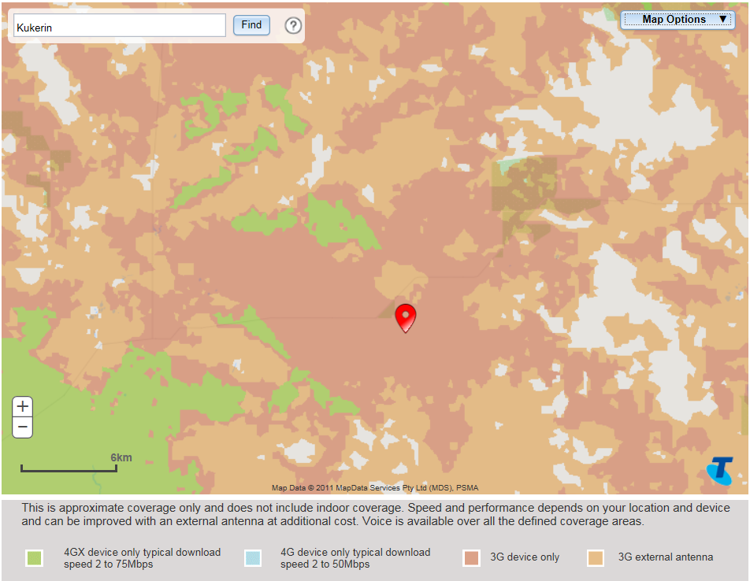
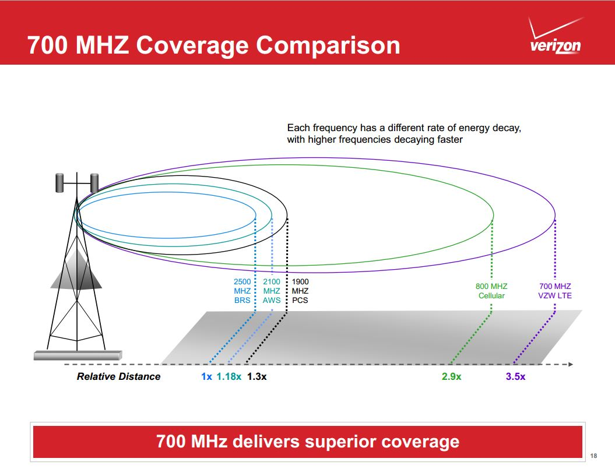
Mobile: Upgrade before Build – 3G to 4GX/Plus

Slide 9
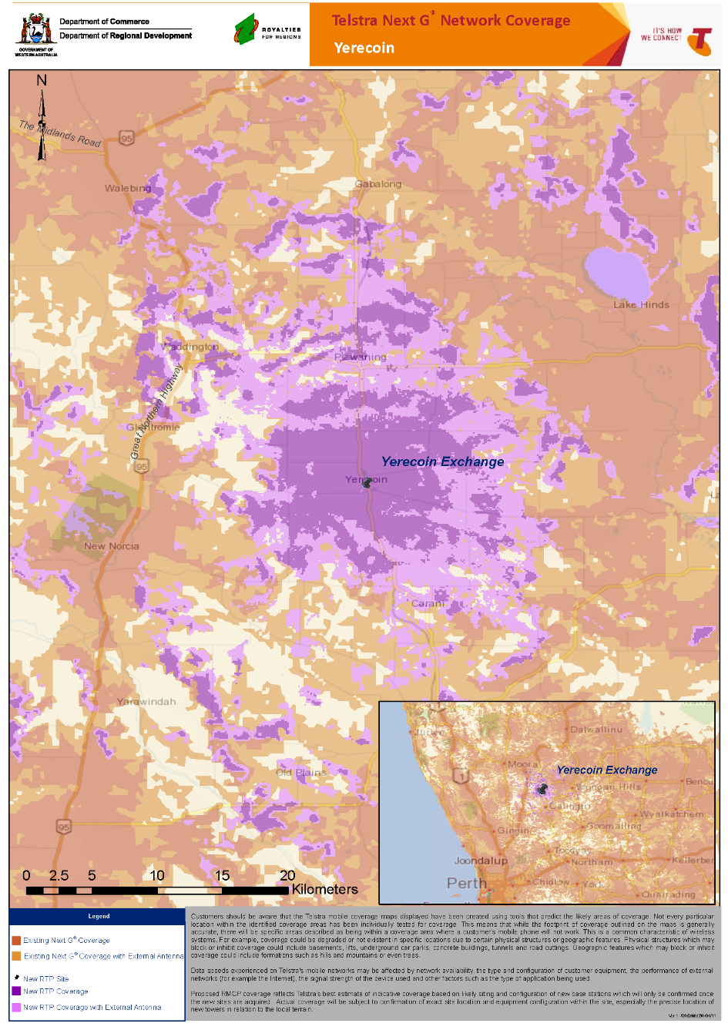
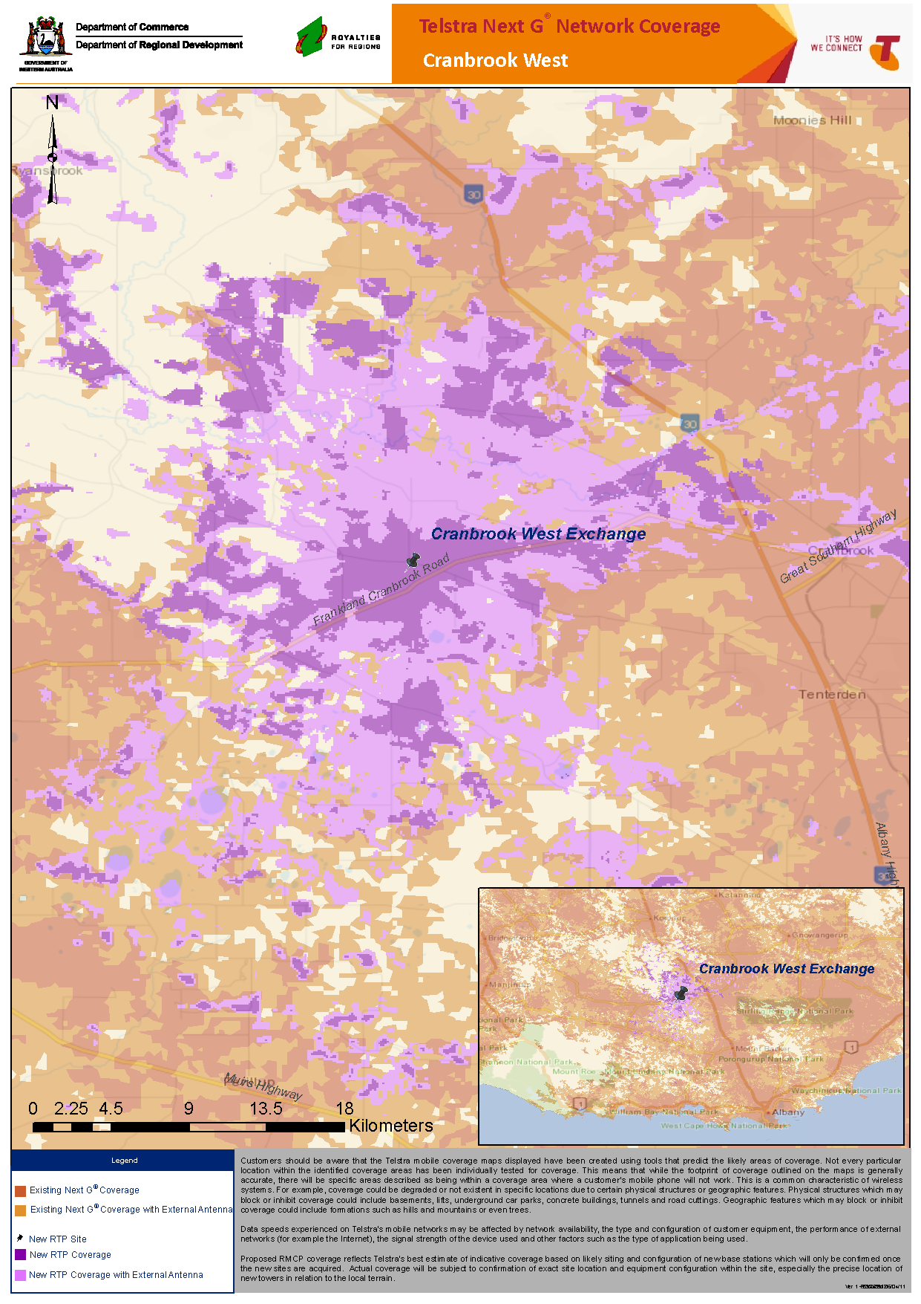
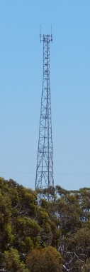

Mobile: Build it right 1st time
Yerecoin - 60m Tower
Cranbrook West - 30m Tower

Slide 10


Local Digital Profile: defines the need!
Digital Citizen: Visual
Areas for monitoring
Increased consumption of streaming video (Online TV/Movies)
Increased broadband connectivity
Increased access to fixed broadband options
Use of Skype as a communication tool, and
The ability to download content (music, games, apps and video).
RTP Baseline Study
Regional Telecommunications Program
RMCP Extension Phase
Site Baseline
Wickepin
June 2015

Slide 11





























The Smart Farming phenomenon
HopgoodGanim Lawyers, 16 May 2016
National Farmers Federation launches Digital Agriculture Service to crunch vast amounts of data and boost farm profit ABC, 14 December 2015
Commonwealth of Australia, 2017
Michael Madigan, The Courier-Mail, August 12, 2016

Slide 12





Opportunity 1: Leverage Regional Stakeholders
Operates over 5,500 km of rail networks across southern WA. This includes extensive communications infrastructure used in the coordination, management and control of rail operations, involving over 180 train movements each day.
In a desperate bid to fight the "data drought" in the bush, farmers and rural groups are joining forces with consumer advocates. 14 organisations have come together to lobby form the Regional, Rural and Remote Communications Coalition.
Municipal broadband deployments are broadband Internet access services provided either fully or partially by local governments. Common connection technologies include unlicensed wireless (Wi-Fi, wireless mesh networks), licensed wireless, and fiber optic cable.
Operates 195 receival and storage facilities located across the Western Australian wheatbelt. Aligns with Brookfield Rail networks.
Research the latest technology applications in agriculture. Recently launched FERTview, an online nutritional services tool that uses growers agronomic and mapping data to help support better fertiliser decisions.
Microsoft puts up $10B to bring broadband internet to millions of rural Americans

Slide 13


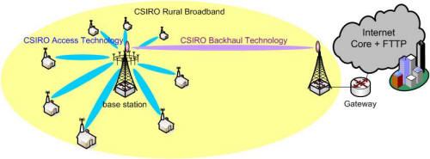
Opportunity 2: Apply Fit for Purpose Technology
Where possible expedite the upgrade from 3G to 4Gx/Plus, to create extra coverage and improve performance, before investing in new sites.
Investigate the use of narrowband wireless solutions and the deployment of LPWAN technologies on a fit for purpose basis. Options such as LoRa present a cost effective solution for extending connectivity, to support IoT applications (in agriculture, tourism, transport, environmental and resources management) across a broad range of industries and functions.
Leverage Australian based innovation such as NGARA Wireless, to provide next generation solutions across rural and regional areas, releasing pressure on the NBN Satellite platform and enabling enterprise grade solutions for rural businesses.

Slide 14
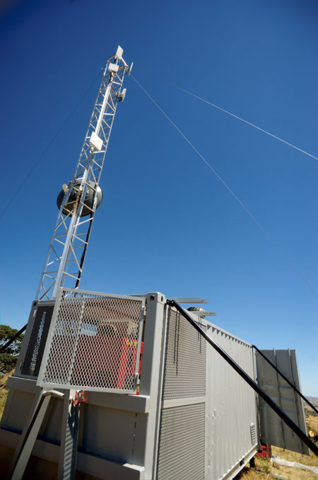
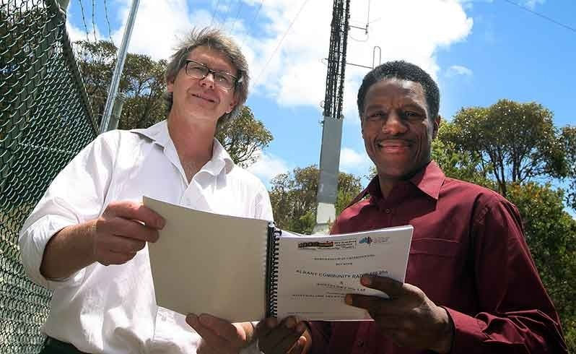
Opportunity 3: Explore Local Cooperative Networks
NEWROC & PEEL
Albany & Great Southern
A new business promising “super fast” internet has launched at a Peel Chamber of Commerce and Industry function in Pinjarra.
South Western Wireless​, which offers fixed wireless internet, is a small business run by Jeremy Devenish, Maree Gooch and Sara Ballard, who all live in regional Western Australia.
A company spokeswoman said their technology was capable of internet speeds of up to 100 Mbps rather than the 10 Mbps currently offered by the major providers, but did not rely on NBN or satellite technology.
The company’s mobile data centre consisted of a modified 20 foot shipping container with a satellite dish and aerial, doubling as a wireless transmission tower designed to deliver high speed internet.
The loss of business in the Great Southern because of the lack of high-speed broadband could end after an agreement was signed this week between a local technology service provider and a community radio station.
The signing of a memorandum of understanding on Tuesday between Albany Community Radio 100.9 and Australian Telephone Networks on the use of the station’s radio mast on Mt Clarence will introduce technology for faster internet downloads in Albany sooner than expected.
The agreement will use microwave technology to cover a wider section of the Albany area.

Slide 15
Opportunity 4: Consider Regional Recognition in legislation
Telecommunications Reform Package, 2017: Regional Broadband Scheme
Enable services to regional areas to be sustainably funded into the future through the introduction of the Regional Broadband Scheme, that will require all eligible broadband network providers to contribute, alongside nbn, towards the long-term costs of regional Australia's nbn satellite and fixed wireless services.
NBN backhaul: Cell Site Access Service (CSAS)
Enables a Customer or its Downstream Customers to supply public mobile telecommunications services (as that term is defined in the Telecommunications Act) via Customer Equipment at a CSAS Point.
Telecommunications Universal Services Obligation Inquiry
This report was sent to Government on 28 April 2017 and publicly released on 19 June 2017. The report recommends taking a new and modernised approach to the subsidy and support arrangements that form the current universal telecommunications services in Australia. Implications for regions.
Non-NBN high-speed internet services
The ACCC’s final decision exempts superfast broadband access service - SBAS (but not Local Bitstream Access Service - LBAS) providers supplying up to 12,000 end users from all wholesale access obligations. The arrangement covers broadband services built before and after January 2011. It does not cover fixed wireless, mobile or satellite services.

